Slide 1
IT Governance
And
Cybercrime
19/04/10
Open Source Forensic Tools

Slide 2
Agenda
What is Open Source
Features Open Source
Relevance to Digital Forensics
Windows Based
Unix Based
Caveats of Open Source
Open Source vs. Closed Source
Future

Slide 3
What is Open Source?
NOT free
License – GNU/GPL/GNU 2.0
Collaboration
Many Iterations
Successful

Slide 4
Features of Open Source?
Cost Effective
RAD – Rapid Application Development
“Great minds think alike”
Standards Compliant
Constantly updated
Can be cross platform

Slide 5
Relevance to Digital Forensic
Many areas – Network, Computer and Environmental for example
Work in the same principal and approach:
  Acquisition
  Extraction
  Analysis
  Report
Environment Independent
  Windows 32/64 bit
  Unix/Linux – 32/64bit

Slide 6

Windows Based Software

Slide 7
Forensic Acquisition Utilities 32/64 bit
Open License – Allows for use in commercial and non-commercial environments
Collection of software
4MB download
Allows collection of data from a running computer
http://www.gmgsystemsinc.com/fau/

Slide 8
FAU – Includes
DD – creates byte-level images of source input
FMData – displays details of file and directory attributes
NC – remake of netcat – read and write data across networks
Volume Dump – shows information about all drives in computer
Wipe – wipes the data from hard drive
http://www.gmgsystemsinc.com/fau/

Slide 9
LiveView
Written in Java
Boots DD-style Hard disk images into the operating system
Requires other free software to run
Auto generation of MBR (if not present)
http://liveview.sourceforge.net/

Slide 10
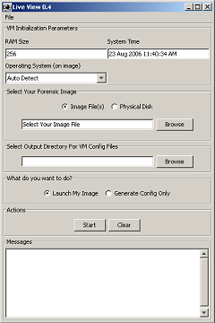
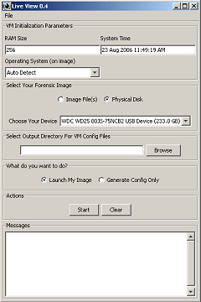
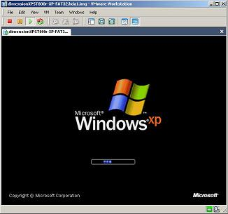
Screenshots of LiveView
Booting operating system in virtual environment
Choose boot type – image or physical drive

Slide 11
TestDisk 6.11
Open source
Recovery of files and partitions
Command line Interface

Slide 12
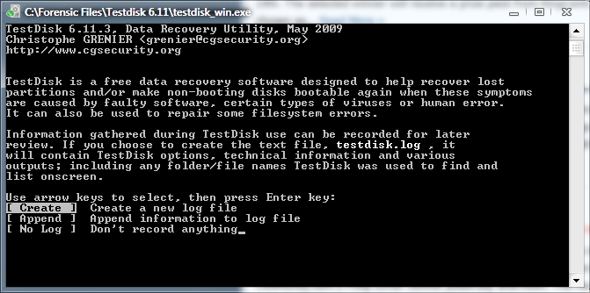
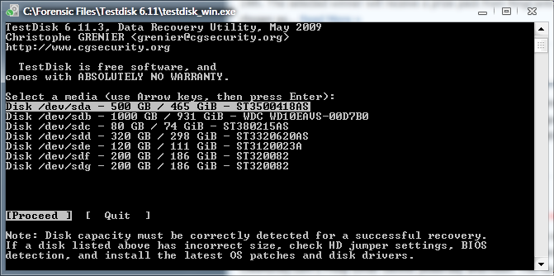
Screenshots of TestDisk 6.11
TestDisk can create logs and work off the logs. This can easily help with long file recovery processes. Or even additional – saving time and time.
Choose the disk from which you want to recover the partitions

Slide 13
Microsoft Coffee
Used specifically by law enforcement (FBI)
Not open source; free
Easy training – can be trained in 10 minutes
Supported by INTERPOL and NW3C (USA)
http://www.microsoft.com/industry/government/solutions/cofee/default.aspx

Slide 14

Unix/Linux Based

Slide 15
AIR – Automated Image Restore
Open source
Provides GUI for DD/DC3DD imaging CLI
User friendly
Does not require knowledge of DD-CLI
http://air-imager.sourceforge.net/

Slide 16
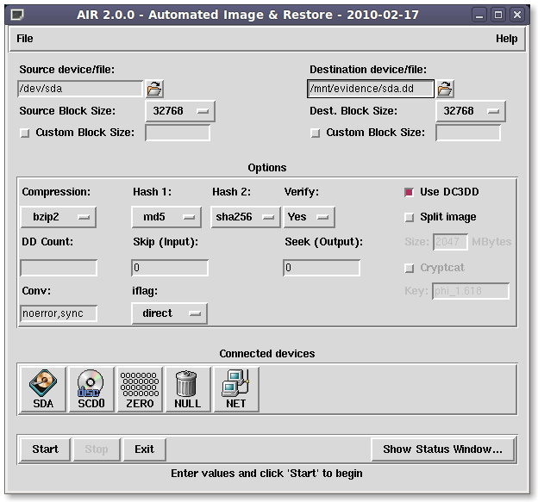
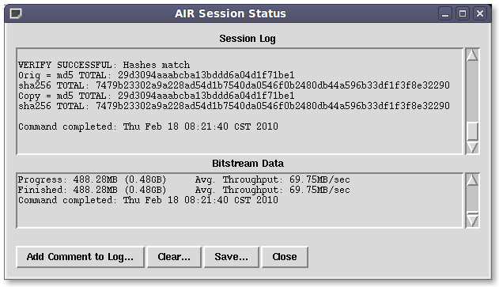
Screenshots of AIR
http://air-imager.sourceforge.net/

Slide 17
The Sleuth Kit (TSK) 3.0.1
Open source
Comes with a GUI “Autopsy Forensic Browser”
Command line analysis tool
Works similar to encase.
Digital Evidence Bag

Slide 18
Caveats of Open Source
Integrity – not validated in the court of Law
Easily reverse-engineered
Can be exploited
No financial backing

Slide 19

Open Source vs. Closed Source
Open source tools are better tested – more time ensuring it meets the standards
Closed source provides manuals and guidelines on usability of application
Support is often phone based – additional charges vs. Online forum based
Direct developer interaction

Slide 20
Future
Demand
Forensic Laboratory
Subject Matter Experts
Validity/Integrity

Slide 21
Thanks...Any Questions?

