Slide 1



Calculating with
Money & Shopping
Choose a level

Slide 2
Calculating with
Money & Shopping
1 Star Question

Slide 3
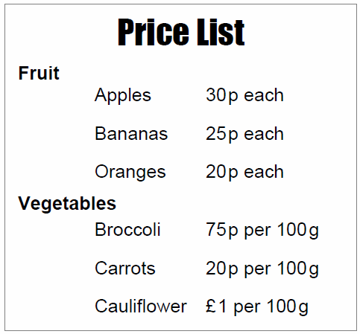
Her is part of a price list for a fruit and vegetable stall.
The government says we should eat 5 portions of fruit and vegetables every day.
A portion is an item of fruit or 100g of vegetables.
2 apples and 3 cauliflowers would count as 5 portions.
How much would this cost each day?
How much would this cost in a week?

Slide 4
Her is part of a price list for a fruit and vegetable stall.
The government says we should eat 5 portions of fruit and vegetables every day.
A portion is an item of fruit or 100g of vegetables.
1 orange, 1 banana, 1 cauliflower and 2 portions of Broccoli would count as 5 portions.
How much would this cost each day?
How much would this cost in a week?

Slide 5
Her is part of a price list for a fruit and vegetable stall.
The government says we should eat 5 portions of fruit and vegetables every day.
A portion is an item of fruit or 100g of vegetables.
Write down 4 other possible combinations of fruit and vegetables and calculate:
How much would each cost each day?
How much would each cost in a week?

Slide 6
Her is part of a price list for a fruit and vegetable stall.
The government says we should eat 5 portions of fruit and vegetables every day.
A portion is an item of fruit or 100g of vegetables.
Dita wants to buy at least two different fruits and two different vegetables.
Write down 3 possible combinations, trying to keep the cost as low as possible.

Slide 7
Her is part of a price list for a fruit and vegetable stall.
The government says we should eat 5 portions of fruit and vegetables every day.
A portion is an item of fruit or 100g of vegetables.
Dita has £10 to spend on fruit and vegetables for one week.
Show one way of buying fruit and vegetables so that she has 5-a-day for one week.
End of Problem
Return to Menu

Slide 8
Calculating with
Money & Shopping
2 Star Question

Slide 9
Her is part of a price list for a fruit and vegetable stall.
The government says we should eat 5 portions of fruit and vegetables every day.
A portion is an item of fruit or 100g of vegetables.
1 orange, 1 banana, 1 cauliflower and 2 portions of Broccoli would count as 5 portions.
How much would this cost each day?
How much would this cost in a week?

Slide 10
Her is part of a price list for a fruit and vegetable stall.
The government says we should eat 5 portions of fruit and vegetables every day.
A portion is an item of fruit or 100g of vegetables.
Dita wants to buy at least two different fruits and two different vegetables.
Write down 3 possible combinations, trying to keep the cost as low as possible.

Slide 11
Her is part of a price list for a fruit and vegetable stall.
The government says we should eat 5 portions of fruit and vegetables every day.
A portion is an item of fruit or 100g of vegetables.
Dita has £10 to spend on fruit and vegetables for one week.
Show one way of buying fruit and vegetables so that she has 5-a-day for one week.
End of Problem
Return to Menu

Slide 12
Calculating with
Money & Shopping
3 Star Question

Slide 13
Her is part of a price list for a fruit and vegetable stall.
The government says we should eat 5 portions of fruit and vegetables every day.
A portion is an item of fruit or 100g of vegetables.
Dita has £10 to spend on fruit and vegetables for one week.
She wants to buy at least two different fruits and two different vegetables.
Show one way of buying fruit and vegetables so that
she has 5-a-day for one week.
End of Problem
Return to Menu

