Slide 2
3-Screen Coding: Sharing code between Windows Phone, Silverlight, and .NET
Shawn Burke
Architect
Microsoft Corporation

Slide 3
Agenda
The Portability Story
Overview – how should portability work?
Introducing the Portable Library Project
Crafting the Portable Subset
Scenario: Sharing code across .NET
Scenario: Sharing code between Silverlight and Windows Phone 7
Wrap up

Slide 4
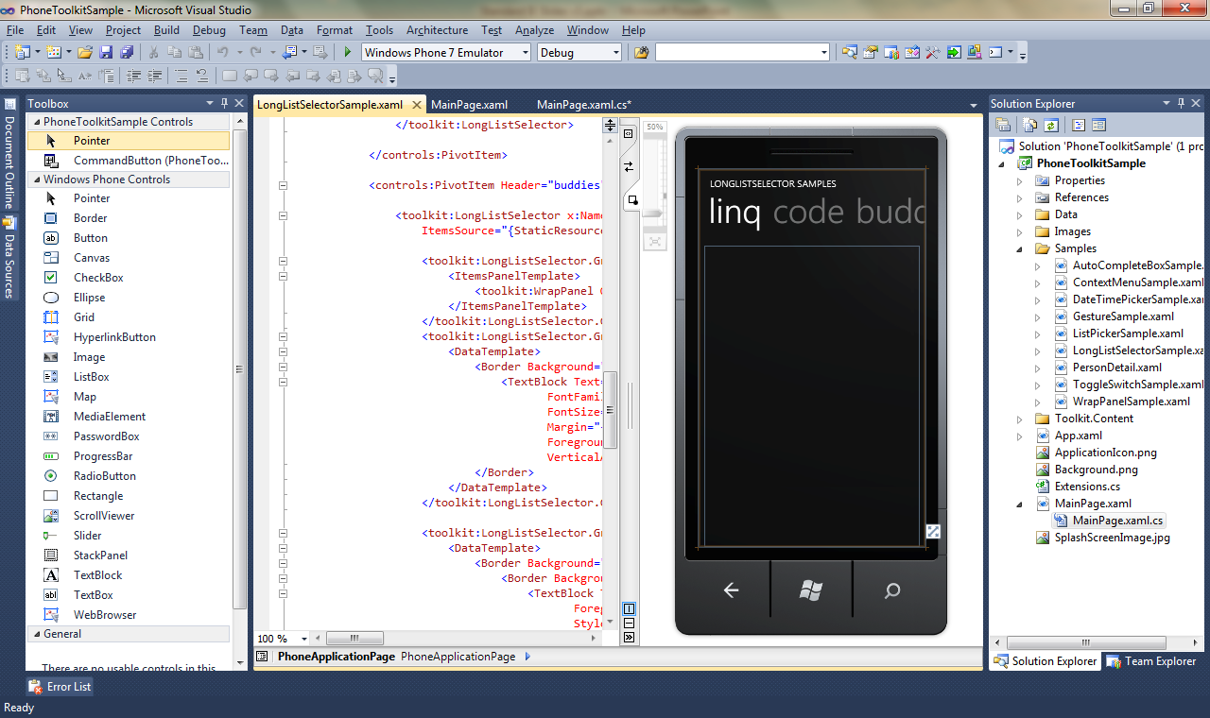
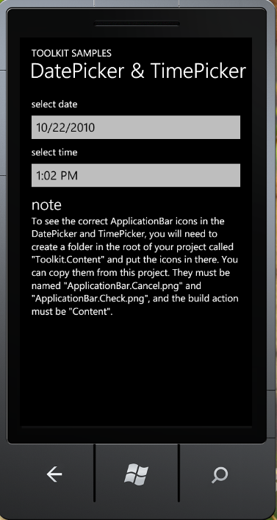
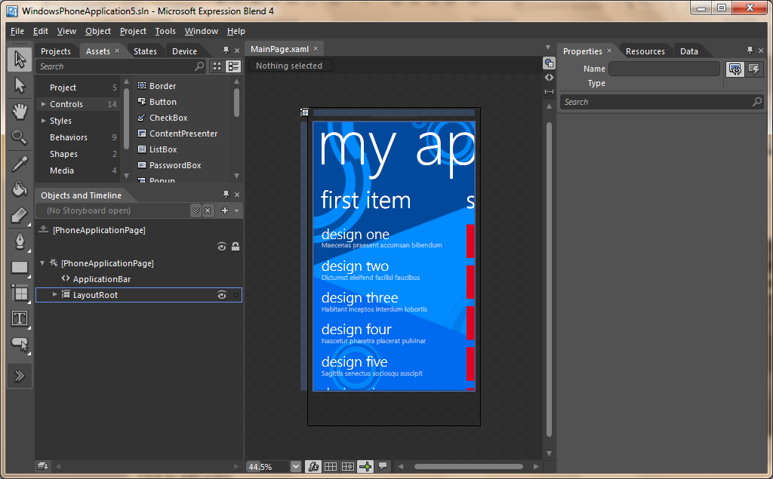
Windows Phone Application & Game Development
Based on Silverlight & XNA Framework, includes templates and behaviors to build consistent and compelling experiences
Free tools including Visual Studio 2010, Expression Blend 4, and the Windows Phone Emulator
Open and transparent Windows Phone Marketplace to reach all Windows Phone users

Slide 5
The arc of the universe bends towards…
My trip around .NET
An offer I couldn’t refuse…
An opportunity to fix a developer pain point
  It’s great being your own customer!
What I’ve learned:
  Sharing code is hard
  Sharing UI is harder
Simplicity and factoring is the key to success

Slide 6
In case you’re just tuning in…
Portability has a rocky past
  Write-Once-Run-Everywhere – not so much
Fragmentation versus agility
  Easy/attractive to fragment early
  Difficult to fix it later
The introduction of a Silverlight platform on the Phone presented a unique opportunity
“Code-Portability” is not good enough – need to be able to share binaries
Good user experience requires form-factor-specific UI
Principles:
  Things that are the same should be the same
  Deliver something that’s sufficient even if it’s thin
  Grow the set over time

Slide 7
Why can’t I just run my app?
Many people first assume they want a Silverlight app to “just run” on the Phone
Issues:
  Some APIs are very platform specific (System.Windows.Browser)
  Screen Size is very different
  Input methods are very different
  Performance characteristics are different
How to handle differences:
  Stub APIs? Emulate? Check availability?
  Visual Studio Magic? Intellisense modes?
  Migration Tool?
Conclusion: Application Portability is not a good solution

Slide 8
Solution Requirements
What are the attributes of a good solution?
  Can target common APIs in a natural way
  Can target APIs that exist on a subset of .NET platforms
  Allows developers to easily target multiple platforms without having detailed or special knowledge of those platforms
  CLR(s) know how to load portable assemblies.
  Portable API surface area can grow and version over time

Slide 9
Component/Logic Portability
It’s much more effective to share logic and components
NET 4.0 introduced assembly portability:
  A Silverlight DLL’s bindings will be redirected to desktop .NET assemblies.
Silverlight
.NET Framework 4.0
MyAssembly.dll
mscorlib.dll (2.0.5.0)
mscorlib.dll (2.0.5.0)
mscorlib.dll (4.0)

Slide 10
Code Portability Scenarios
The “heavy lifting” in many apps is done in a very portable way:
  Business Logic
  Validation Code
  File/Protocol processors
  Serialization
  Service Access
  View Models
  Authentication Code
With these assets, building device-specific UI is easy!

Slide 11
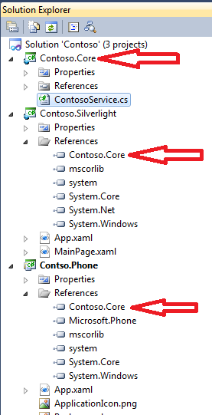
The Portable Library Project
Based on a Class Library project type
Uses reference assemblies to show only APIs that work across selected platforms
At runtime, it’s still just a Silverlight DLL
Easy separation:
  Portable code goes into a portable library project
  Platform specific code goes into the application project
Can be extended with advanced techniques like dependency injection, etc.

Slide 12
Reference Assembles Explained
Runtime
MethodA
Reference assemblies expose metadata
May have different metadata from the assembly at runtime
Used for:
  Complilation
  IntelliSense
MyAssembly.dll
Foo.MethodA
Design Time
System.DLL
Foo.MethodA
Foo.MethodB
Foo.MethodC
MyAssembly.cs
Compiler/IntelliSense
[Reference Assembly]
System.DLL
Foo.MethodA
Foo.MethodB
Foo.MethodC

Slide 13
Hello Portable World
demo

Slide 14
Crafting the Portable Subset
Start with the API surface intersection
Modify intersection with the following consideration
  Security model differences (System.Runtime.InteropServices.Marshal)
  Platform differences (File Paths)
  Runtime differences (Reflection.Emit)
  Behavior differences (Serialization)
  Best practice differences (AppDomain.Create)
  Random differences (missing APIs that “should” be there)
Goal:
  BCL basics + XML processing + Basic Networking
  Fix as many differences as reasonable and possible
  Grow the subset over time
  Allow for targeting specific platforms

Slide 15
Our first try...
Each platform is a subset of the next
This would mean the ‘shared’ subset is simply the smallest platform
In this case, the ‘Phone API’ could be the ‘portable subset’
Unfortunately….doesn’t work.
Desktop API
Silverlight API
Portable Subset

Slide 16


Take Two…
Desktop
Now we can see there’s 3 basic types:
  Available everywhere
  Available on more than one platform
  Available only on one platform
This is good! It allows targeting smaller platform sets
3
Desktop only
1
2
Desktop / Silverlight
1
2
2
Portable Core (Available everywhere)
Desktop / Phone
3
3
Silverlight only
2
Silverlight / Phone
Phone only
3
Silverlight
Phone

Slide 17
What Goes Where
 | Portable Core | Silverlight | Windows Phone
Basic BCL | X | X | X
Basic HTTP | X | X | X
System.Xml | X | X | X
WCF Client |  | X | X
MEF | X | X
System.Windows (UI) |  | X | X

Slide 18
Portability across client & server –
File Parsing
demo

Slide 19
Portability Across Clients – View Model
demo

Slide 20
Roadmap
If you want to write portable code today:
  Write code in Silverlight 3 DLL
    Need to use “Browse…” to reference the DLL
    Ignore warning when adding to Phone project
  Be careful about the APIs you reference
  Test!
Portable Library Project: H1 2011
Future:
  Adding new functionality areas
  Expanding the Portable Core

Slide 21
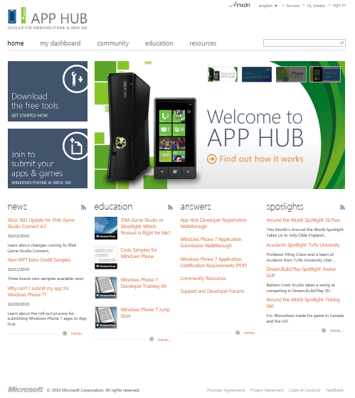
Resources
Download the Windows Phone Developer Tools from App Hub
  http://create.msdn.com
Join to submit your Apps & Games
  http://create.msdn.com
XNA Education Roadmap
  http://create.msdn.com/en-us/education/roadmap
Silverlight Video Resources
  http://www.silverlight.net/learn/videos/windows-phone/
WP7 Training Kit
  http://channel9.msdn.com/Learn/Courses/WP7TrainingKit

Slide 22
Windows Phone 7 at PDC 2010
Day 1 – Thursday 10/28
Day 2 – Friday 10/29
Kodiak | 11:30 – 12:30 | Building WP7 Apps with Windows Azure
Kodiak | 2:00 – 3:00 | Things I Wish I Knew Three Months Ago about Building Windows Phone 7 Applications
Kodiak | 3:15 – 4:15 | Optimizing Performance for Silverlight Windows Phone 7 Apps
McKinley | 4:30 – 5:30 | 3-Screen Coding: Sharing code between Windows Phone, Silverlight, and .NET
Hood | 11:30 – 12:30 | Things you Need to Know Before Building XNA Framework Games
Hood | 2:00 – 3:00 | Real World Analysis and Optimization of XNA Framework Games on WP7

Slide 23

© 2010 Microsoft Corporation. All rights reserved. Microsoft, Windows, Windows Vista and other product names are or may be registered trademarks and/or trademarks in the U.S. and/or other countries.
The information herein is for informational purposes only and represents the current view of Microsoft Corporation as of the date of this presentation. Because Microsoft must respond to changing market conditions, it should not be interpreted to be a commitment on the part of Microsoft, and Microsoft cannot guarantee the accuracy of any information provided after the date of this presentation. MICROSOFT MAKES NO WARRANTIES, EXPRESS, IMPLIED OR STATUTORY, AS TO THE INFORMATION IN THIS PRESENTATION.

Slide 24
Designing Portability: Common API surface
.NET Framework
Silverlight
Windows Phone 7
System.Mangement
System.Web
…
System.Drawing
System.Windows.Browser
Microsoft.Phone
System.Windows.Forms
System.Windows
System.Windows
System.ServiceModel
System.ServiceModel
System.ServiceModel
“Portable Core”
System.Xml
System.Xml
System.Xml
System.Core
System.Core
System.Core
System
System
System
mscorlib
mscorlib
mscorlib

