Slide 1

Design and Development Trends in Mobile

Slide 2
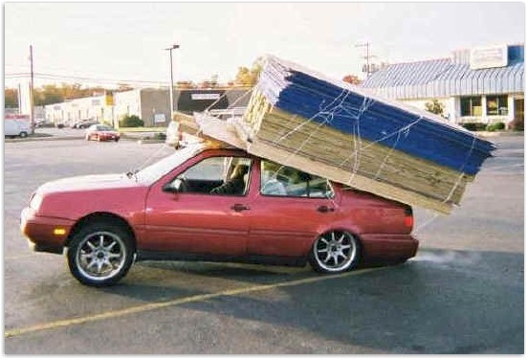
Here comes the overload!

Slide 3


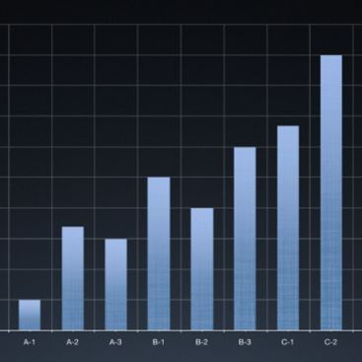

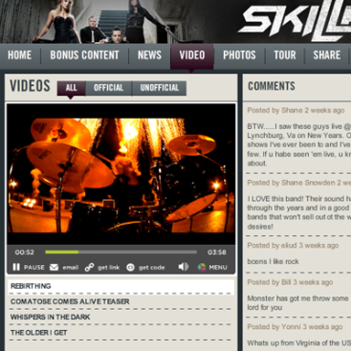


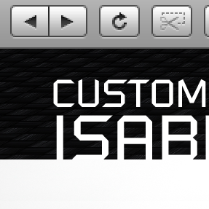

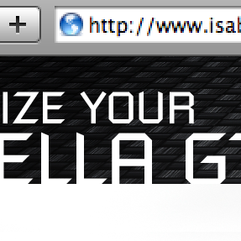
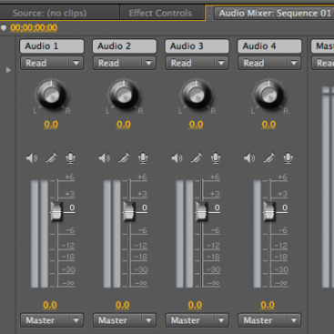




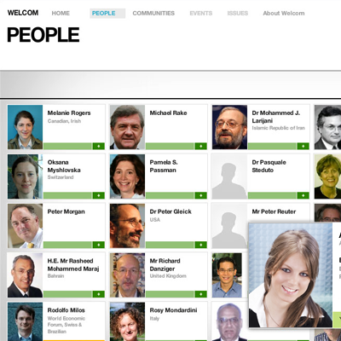

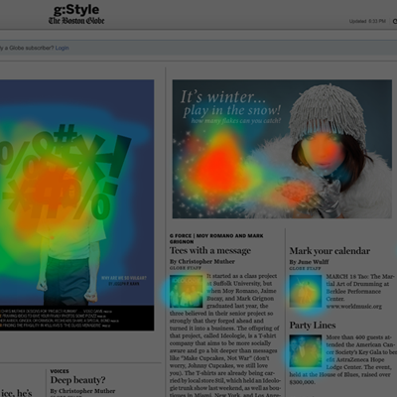
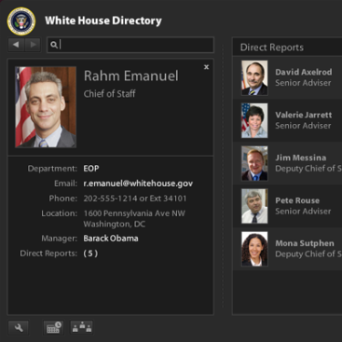

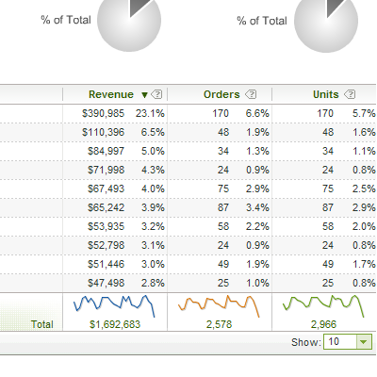


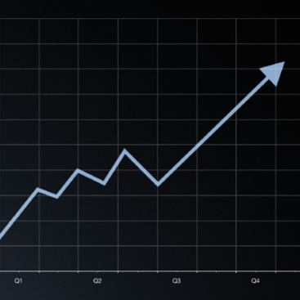

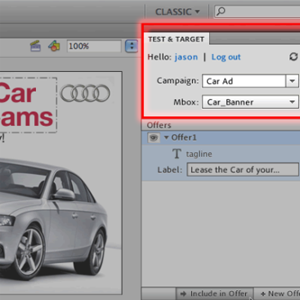
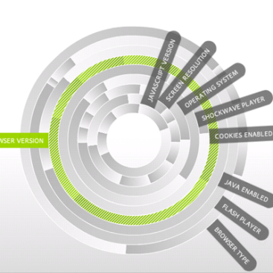



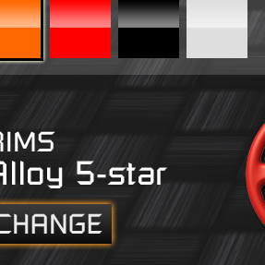
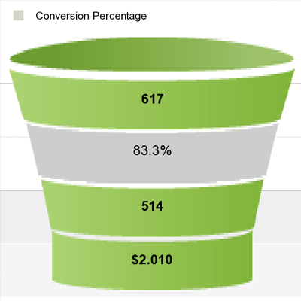

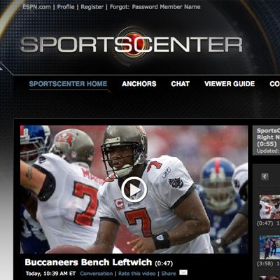
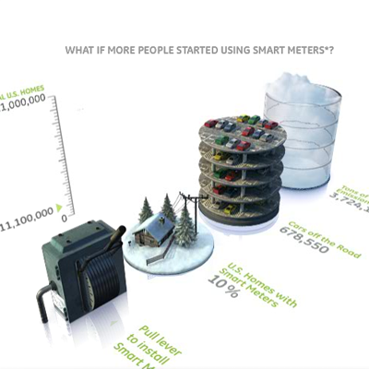

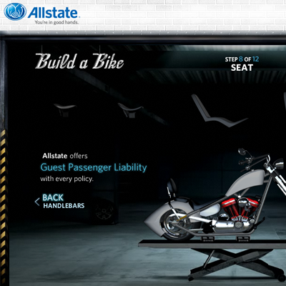
TREND:
CONTENT
TO
CONTENT+
APPLICATIONS
Adobe revolutionizes
how the world
engages with ideas
and information
3
Notes:
TECHNOLOGY TRENDS/1
First, the distinction is blurring between content and applications. For example, before you would view an auto website online; now you can also configure your car, schedule a test drive and purchase. This is one example of the engaging experiences consumers have come to expect.
Therefore, companies need to be able to do more with their information and assets, more easily and more quickly. They need to be able to take content and manipulate it, use it for commerce or critical business through applications.

Slide 4






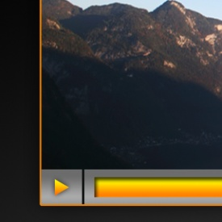



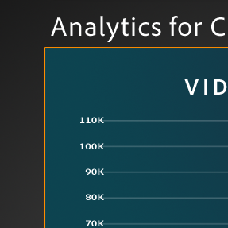
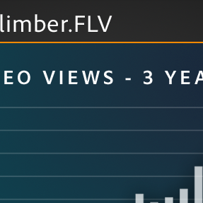
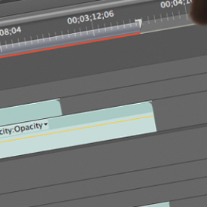

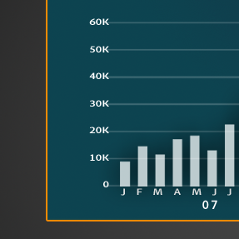
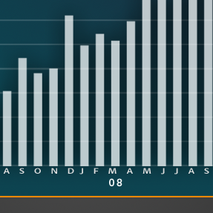
TREND:
CREATION
TO
CREATION+
OPTIMIZATION
Adobe revolutionizes
how the world
engages with ideas
and information
4
Notes:
TECHNOLOGY TRENDS/2
Second, it is no longer enough to create incredible things and deliver them across media. There is an increasing challenge to complete the loop of how that content performs through measurement and optimization. Companies need to deliver the right content to the right person for maximum business results.
This was the motivation behind our acquisition of Omniture, which we completed in October 2009, and has been a growing focus across our technologies and products.

Slide 5













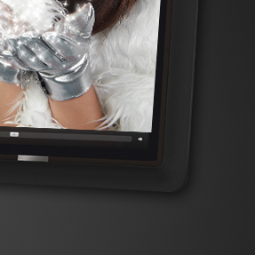


TREND:
ONE DEVICE
TO
MULTISCREEN
Adobe revolutionizes
how the world
engages with ideas
and information
5
Notes:
TECHNOLOGY TRENDS/3
Finally, the world is quickly evolving from content and applications being custom-designed for one device to needing to move seamlessly across every or any screen in a consumer’s life: from PCs to smartphones, tablets and TVs.
People want information when they want it, how they want it – which naturally differs depending on the device, the content, the channel, and the setting. This adds a lot of complexity for businesses, designers and developers.

Slide 6




RIA and Mobile Technical Considerations
Rich + Reach
Local Processing + Hosted Services
Content Manipulation
Application/Communication
Advanced MEP’s (not just async)
Integration into processes
Notes:
For MEPs – mention the data paging pattern in particular as it is relevant to mobile development.

Slide 7
Some names you should know:
Flash – a complete platform from Adobe including servers, protocols, binary formats, runtimes, development tools and frameworks.
SWF – a file format used within the Flash platform
Flash Player – the runtime browser plugin
AIR 2.0 – the desktop runtime.
Flash Builder 4 – newest iteration of IDE for Flex/AIR (formerly “Flex Builder 3.*)
  Can build SWF’s (run in Flash Player) or AIR.
Flex 4 – newest iteration of the Flex Framework and SDK.
Packagers – ability to package applications built with Adobe IDE’s for other platforms such as the iPhone/iPad.
  Packaged as native applications.
Livecycle – the enterprise services and BPM tier of Adobe’s stack.

Slide 8
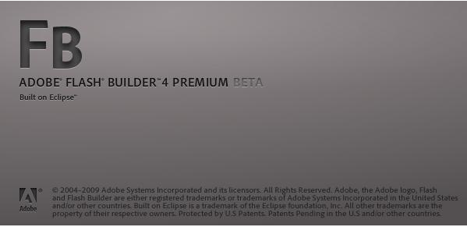
Adobe® Flash™ Builder™
Next evolution of “Flex Builder 3”
  Uses the Flex Framework v.4 (Halo & Spark)

Slide 9

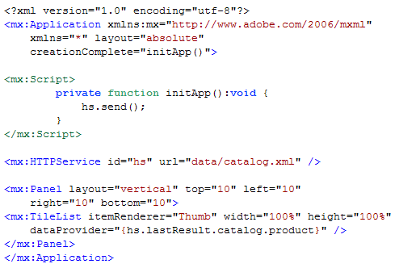
How Flex Works
Flex Builder IDE
Browser
Adobe AIR
MXML and ActionScript
Flash Player
Flex SDK
MXML
ActionScript
Flex Class Library
SOAP
HTTP/S
AMF/S
RTMP/S
Web Server
Compile
XML/HTTP
REST
SOAP Web Services
J2EE Application Server
BlazeDS or
LC Data Services
.swf
Existing Applications and Infrastructure
.swf
Notes:
Lets have a look at how Flex works and fits into existing infrastructure.
First is the application server, Flex uses the existing application server. If you don’t have one, Macromedia can provide one for you.
On top of the application server, sits the Flex Presentation Server. Flex is broken down into two areas. A client-side Application Framework and the server-side Run-time services.
The Application Framework consists of
an XML declarative programming language for laying out and defining rich user experiences, which is code named MXML
ActionScript which is the Flex programming language for procedural programming
The class library, which consists of components like containers & controls and managers for commonly used services. These provide the building blocks for creating great user experiences
Flex Run-time Services provide services for Flex
Web Services proxy for interaction between the client and enterprise data sources
Java object connectivity which allows you to invoke methods on local or remote objects
Player detection which detects and locally deploys Flash client as necessary
and performance optimizations like content caching and deferred instantiation.
And Flex applications can be built using leading IDEs or text editors. We’re also working on a new technology, code named Brady, which is based on Dreamweaver MX 2004 and enables visual layout and code editing of Flex applications.
Note to speaker: If you click on the “IDEs and text editor” box, that will take you a large screen shot of Flexstore code in Brady. If you click that image, it will take you back to this slide. If you click on the Brady box, it will take you to a large screenshot of Brady. And then if you click on that image it will take you back again.

Slide 10
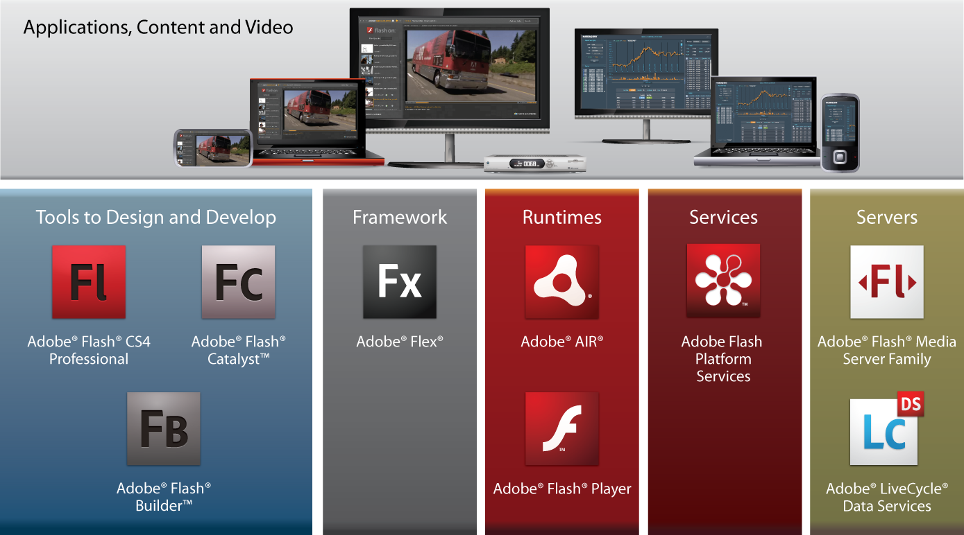
Flash Platform - A complete system for web innovation

Slide 11

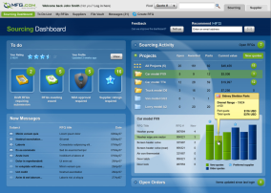




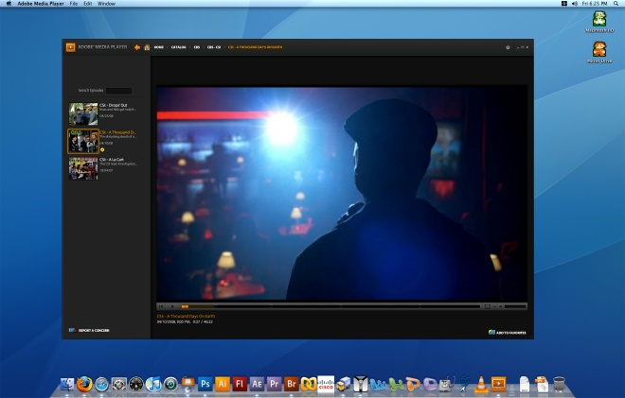


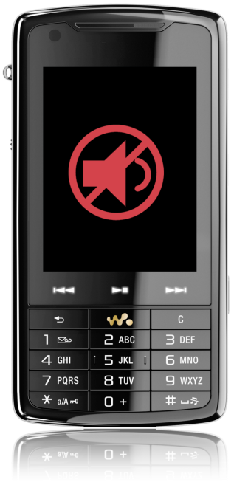

Web browsing client roadmap
Desktop Class
Flash Player
10.1
Flash Player 10
Upper Tier Devices
Flash Lite 3.1
Lower Tier Devices
Flash Enabled
Pre 2009
2010
Notes:
11
Shipping in the first half of 2010, Flash Player 10.1 will extend its reach to a broad range on Internet-connected devices, including smartphones, smartbooks, netbooks, game consoles and PCs. Flash Lite 4 will move to support content built using ActionScript 3. Flash Lite continues to be a very successful product that has shipped on over one billion devices and growing. There continues to be demand from many OEMs for Flash Lite for lower powered mass market devices while higher power devices are moving to Flash Player 10.1 (and AIR in the future). We continue to evaluate the market conditions at this time to determine the best path for our OEM and developer partners.

Slide 12
Flash Player 10.1 is designed for mobility!
Performance
  Graphics hardware acceleration
  Audio/video hardware decoding
  Memory, battery & CPU optimizations
  Optimized SWF Management
  Sleep mode
Device integration
  Multi-touch and gestures
  Accelerometer
  Screen orientation
  Mobile text input
  Porting kit for OSP partners
Notes:
Note: The performance improvements represent averages across 5 different benchmarks for each metric, using an HTC Fuze smartphone running Windows Mobile 6.5. Software rendering performance represents an average framerate. Many of the optimizations are specific to phones. For example, we added optimizations that only apply when the screen is 16-bits-per-pixel, which is common on phones but non-existent on desktops. We wouldn’t expect to see a dramatic speed increase in the Windows/Mac desktop version of the player.
To make it possible to deploy SWF content on smartphones and other mobile devices that have limited processing power and memory availability compared to PCs, a tremendous amount of engineering work has gone into to making Flash Player 10.1 “ready for mobility”. This work includes performance improvements, such as rendering, scripting, memory, start-up time, battery and CPU optimizations, in addition to hardware acceleration of graphics and video. Improvements in memory utilization and management, start-up time, CPU usage, and rendering/scripting performance benefit PCs as well as mobile devices.
New mobile-ready features that take advantage of native device capabilities including support for multi-touch, gestures, mobile input models, accelerometer and screen orientation, bringing unprecedented creative control and expressiveness to the mobile browsing experience.
Contextual applications that span different devices can adapt to different software and device contexts to provide optimized user experiences and deliver improved business results.

Slide 13
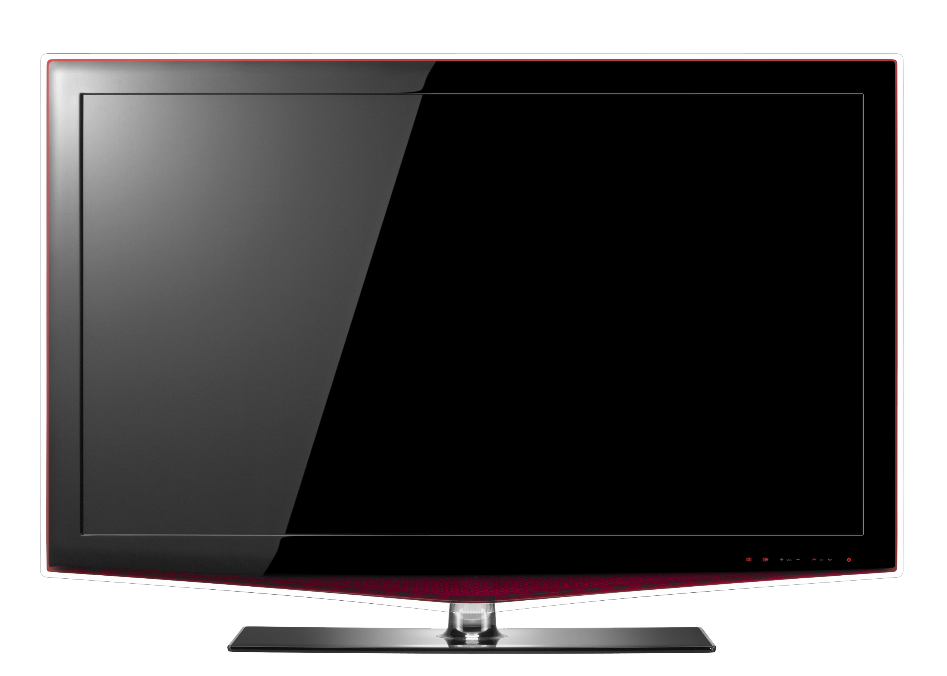
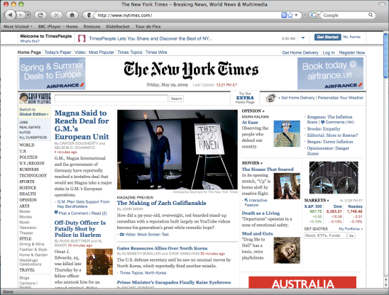
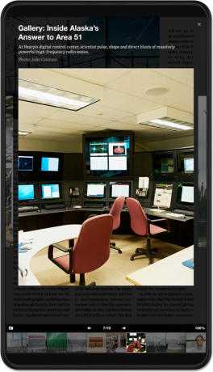
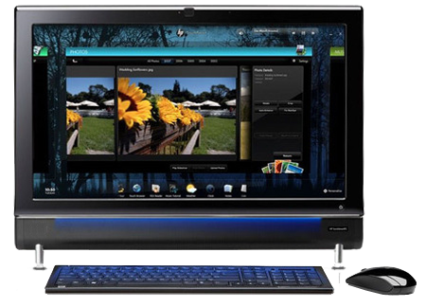

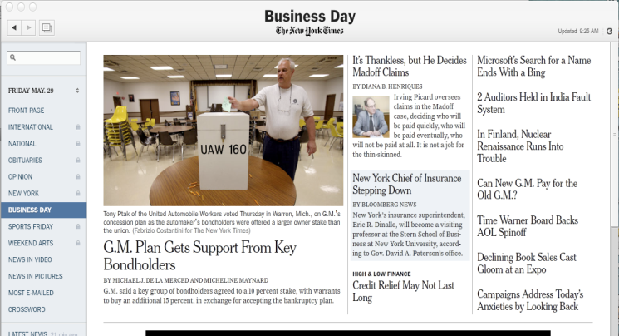
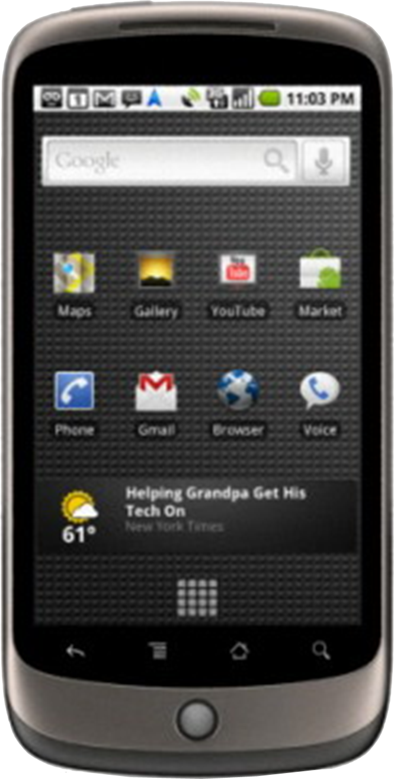


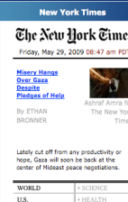









Multi Screen: Same Programming Model, Same Tools, Same Code
Applications becoming available on exploding number of devices
Trend is to build “standalone apps” as opposed to “browser apps”
Building native apps for each device is unsustainable for most organizations
Flash provides abstraction layer on top of all these devices
Notes:
Applications are becoming available on an exploding number of devices (laptops, desktops, phones, tablets, TVs, etc.) powered by Windows, MacOS, Linux, iOS, Android, BlackBerry, Palm, Windows Mobile, etc.
On devices, the trend is to build standalone apps as opposed to browser apps: for example, if you want to do Home Banking on your phone, Bank of America will drive you to their standalone app sitting on your phone “desktop”, not to their browser app.
But building native apps for each device (iOS, Android, Blackberry, Palm, Windows Mobile) in addition to the desktop operating systems (Windows, MacOS, Linux) is unsustainable for many organizations.
The Flash Platform and AIR offer an abstraction layer on top of these devices and will allow you to build your application once and deploy it on all of these devices (with the exception of iOS devices): same programming model, same language, same toolset, same code.

Slide 14




















































Open Screen Project
Technology Partners
Content Partners
Notes:
OSP partners to date are listed here – close to 70 industry leaders in the mobile, PC, and TV space
Span all key parts of the value chain
Chipset/silicon vendors
World’s leading handset and device OEMs
Carriers
Content providers
We’ve added many new members to the OSP since MAX – continuing to see strong participation by technology partners. Now focus has recently shifted to seeing a lot more energy on the content partners, who are working with the developer beta of our runtimes to make sure their content works, and to provide improved experiences for those using devices on the Flash Platform.

Slide 15


AIR extends the benefits of Flash Player
Richer and more engaging user experiences out of the browser
Empower Flash developers to deploy applications in app catalogs
Leverage desktop AIR app ecosystem
Shared codebase and porting with Flash Player
Geo-Location
SQLite
Application Update Framework
Application Lifecycle
.AIR File format for multi-screen applications
Enhanced Application Security model
Marketplace Distribution
Mobile Hardware Softkey Support
File-System Access (if allowed)
MediaLibrary API
Native Extensibility
  ActionScript3 Support
  Memory, battery & CPU optimizations
Audio/Video hardware decoding
Optimized SWF management
Multi-touch and Gestures
Hardware Acceleration
Mobile Text input

Slide 16
Three methods available – AIR for Android
Develop in Flash Builder 4.01 and release as *.AIR files
Develop in Flash Builder 4.01 and cross compile
Develop in Flash Builder 4.5

Slide 17




Deploying AIR Android Applications
AIR Applications are packaged up as .APK files
  Will be distributed through Android Market and other catalogs
  AIR Application upgrade mechanism through Android Market
AIR Runtime will be distributed in Android Market as Shared Library
  Users will have to download the Runtime once for all AIR applications
  Upgrade through the Android Market
Chroma Circuit.air
Chroma Circuit.apk
Android Market
Android Device

Slide 18
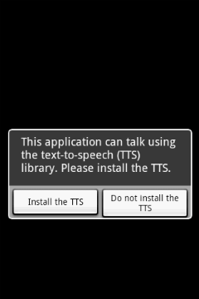

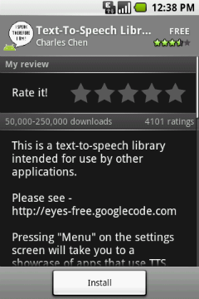
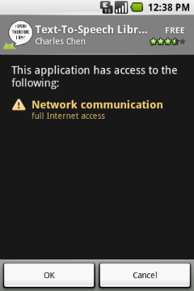
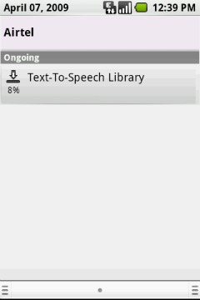
End User Experience for Android Users if AIR is not pre-installed
First time AIR app launches, user prompted to download shared library
Android Market client directs user to AIR Runtime
User is given information on AIR Runtime
User confirms APIs used by AIR Runtime
AIR Runtime is installed
®

Slide 19
Develop in Flash Builder 4.01 and release as *.AIR files
Develop in Flash Builder 4.01 and cross compile
Develop in Flash Builder 4.5

Slide 20
Deployment
ADT is the AIR packager (apk target only available in AIR 2.5):
adt -package -target apk -storetype pkcs12 -keystore a.p12 a.apk a-app.xml a.swf
ADB is the Android SDK deployer
adb install -r a.apk
DEMO
Notes:
On this slide do a demo

Slide 21
Develop in Flash Builder 4.01 and release as *.AIR files
Develop in Flash Builder 4.01 and cross compile
Develop in Flash Builder 4.5

Slide 22
Mobile Flex Components
MobileApplication - Main mobile class
ActionBar - Header for title and navigation
View - Title, viewActivate Event, viewDeactivate Event
ViewNavigator - Stack of Views with animated transitions
  pushView(ViewClass, data); popView();
Mobile Skins
  Form Skins:
  <s:FormItem label="Foo" skinClass="spark.skins.spark.StackedFormItemSkin">
Touch support in Scroller (List, etc)

Slide 23
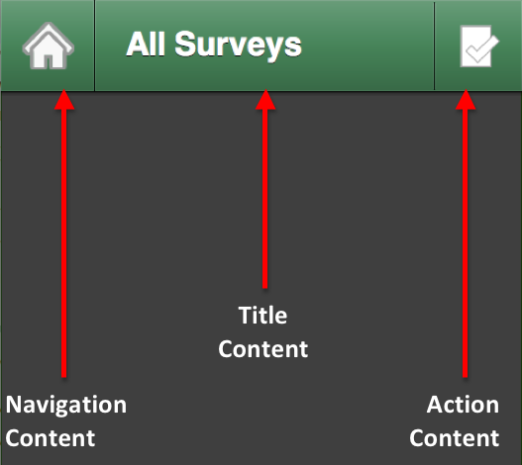
Basic Anatomy of a Flash Builder 4.5 mobile app
View
Navigator

Slide 24
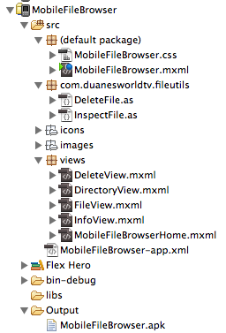
Flash Builder 4.5 Project Anatomy
Project Folder
Default Package
Main entry point into Application
Stylesheet
Library package
ActionScript classes
Views package
Other Views
Application Descriptor
Default First View
Android Native Package

Slide 25
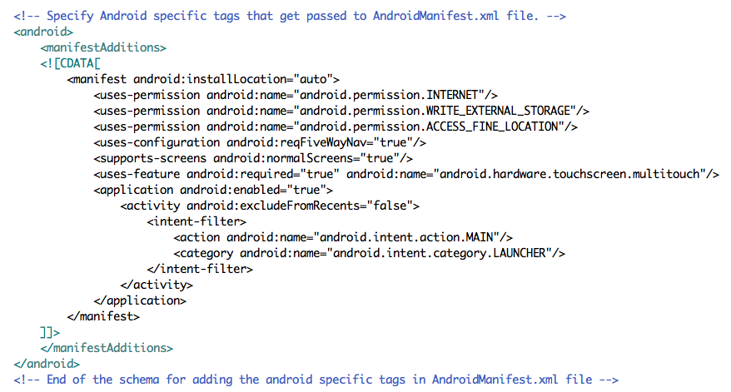
Android Manifest (in Application Descriptor)

Slide 26
GEO APIs
Android Permission Required:
<uses-permission android:name="android.permission.ACCESS_COARSE_LOCATION" /> <uses-permission android:name="android.permission.ACCESS_FINE_LOCATION" />
Geolocation.isSupported
g.addEventListener(GeolocationEvent.UPDATE, callbackFunction);
GeolocationEvent:
  altitude
  heading
  horizontalAccuracy
  latitude
  longitude
  speed
  timestamp
  verticalAccuracy

Slide 27
Accelerometer APIs
Accelerometer.isSupported
a.addEventListener(AccelerometerEvent.UPDATE, callbackFunction);
AccelerometerEvent:
  accelerationX
  accelerationY
  accelerationZ
  timestamp

Slide 28
Multi-Touch APIs
Android manifest change:
<uses-feature android:required="true" android:name="android.hardware.touchscreen.multitouch"/>
Gesture OR Multitouch --- Multitouch.inputMode
MultitouchInputMode.GESTURE
  TransformGestureEvent
    GESTURE_PAN
    GESTURE_ROTATE
    GESTURE_SWIPE
    GESTURE_ZOOM
  GestureEvent.GESTURE_TWO_FINGER_TAP
  PressAndTapGestureEvent.GESTURE_PRESS_AND_TAP
MultitouchInputMode.TOUCH_POINT
  TouchEvent
    TOUCH_BEGIN
    TOUCH_END
    TOUCH_MOVE
    TOUCH_OUT
    TOUCH_OVER
    TOUCH_ROLL_OUT
    TOUCH_ROLL_OVER
    TOUCH_TAP

Slide 29
Remote Data
Android Permission Required:
<uses-permission android:name="android.permission.INTERNET"/>
Standard Flex Networking Libraries:
  HTTPService
  WebService
  RemoteObject

Slide 30
Full Screen & Orientation
stage.displayState = StageDisplayState.NORMAL
stage.displayState = StageDisplayState.FULL_SCREEN
stage.displayState = StageDisplayState.FULL_SCREEN_INTERACTIVE
StageOrientationEvent:
stage.addEventListener(StageOrientationEvent.ORIENTATION_CHANGE, callbackFunction);
foo-app.xml:
<initialWindow>
<autoOrients>true</autoOrients>

Slide 31
Camera Access
Camera - Raw camera feed
<uses-permission android:name="android.permission.CAMERA" />
<uses-feature android:name="android.hardware.camera" android:required="true"/>
<uses-feature android:name="android.hardware.camera.autofocus" android:required="false"/>
<uses-feature android:name="android.hardware.camera.flash" android:required="false"/>
CameraUI - Native Camera App
var cameraUI:CameraUI = new CameraUI();
cameraUI.launch(MediaType.IMAGE);
CameraRoll - Choose photos from the device's camera roll
var cameraRoll:CameraRoll = new CameraRoll();
cameraRoll.browseForImage();
cameraRoll.addBitmapData(bd);

Slide 32
Native App Integration
Open Email, Browser, Maps, Phone, or SMS
  navigateToURL(new URLRequest('mailto:foo@bar.com'));
  navigateToURL(new URLRequest('http://www.jamesward.com'));
  navigateToURL(new URLRequest('http://maps.google.com/'));
  navigateToURL(new URLRequest('tel:1234567890'));
  navigateToURL(new URLRequest('sms:1234567890'));

Slide 33
Local DB APIs
SQLite - Nothing different than AIR for the Desktop
SQLConnection
  Sync and/or Async connections
SQLStatement
  Prepared Statements:
var stmt:SQLStatement = new SQLStatement();
stmt.sqlConnection = FlexGlobals.topLevelApplication['sqlConnection'];
stmt.text = "INSERT into giberish values(:giberish)";
stmt.parameters[":giberish"] = g.text;
stmt.execute();

Slide 34
StageWebView
Requires Android INTERNET permission:
<uses-permission android:name="android.permission.INTERNET" />
WebStageView.isSupported
var swv:StageWebView = new StageWebView();
swv.viewPort = new Rectangle(0, stage.height - height, width, height);
swv.stage = stage;
swv.loadURL("http://www.jamesward.com");

Slide 35

Thank you
Where to learn more:

Slide 36
Microphone

Slide 37
Custom URIs

Slide 38
Soft Keys

Slide 39
Debugging
adb logcat
trace() and errors - only with apk-debug target

Slide 40
Learn more
http://labs.adobe.com
http://opensource.adobe.com
http://www.jamesward.com

