Slide 1

Airpower & ISR in
The Information Age
Lt Gen David Deptula
Deputy Chief of Staff for Intelligence, Surveillance, and Reconnaissance

Slide 2
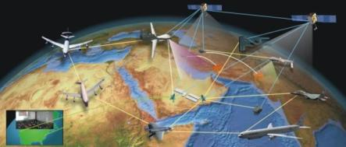

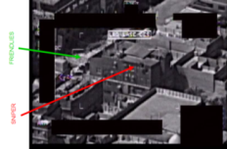
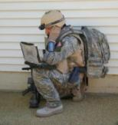
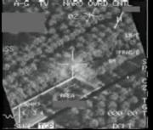

Overview
Info in War Revolution
20th Century Challenges
Threats
21st Century Challenges
Tenets of AF ISR Transformation
AF ISR Transformation
Emerging challenges
Domains & Environments

Slide 3
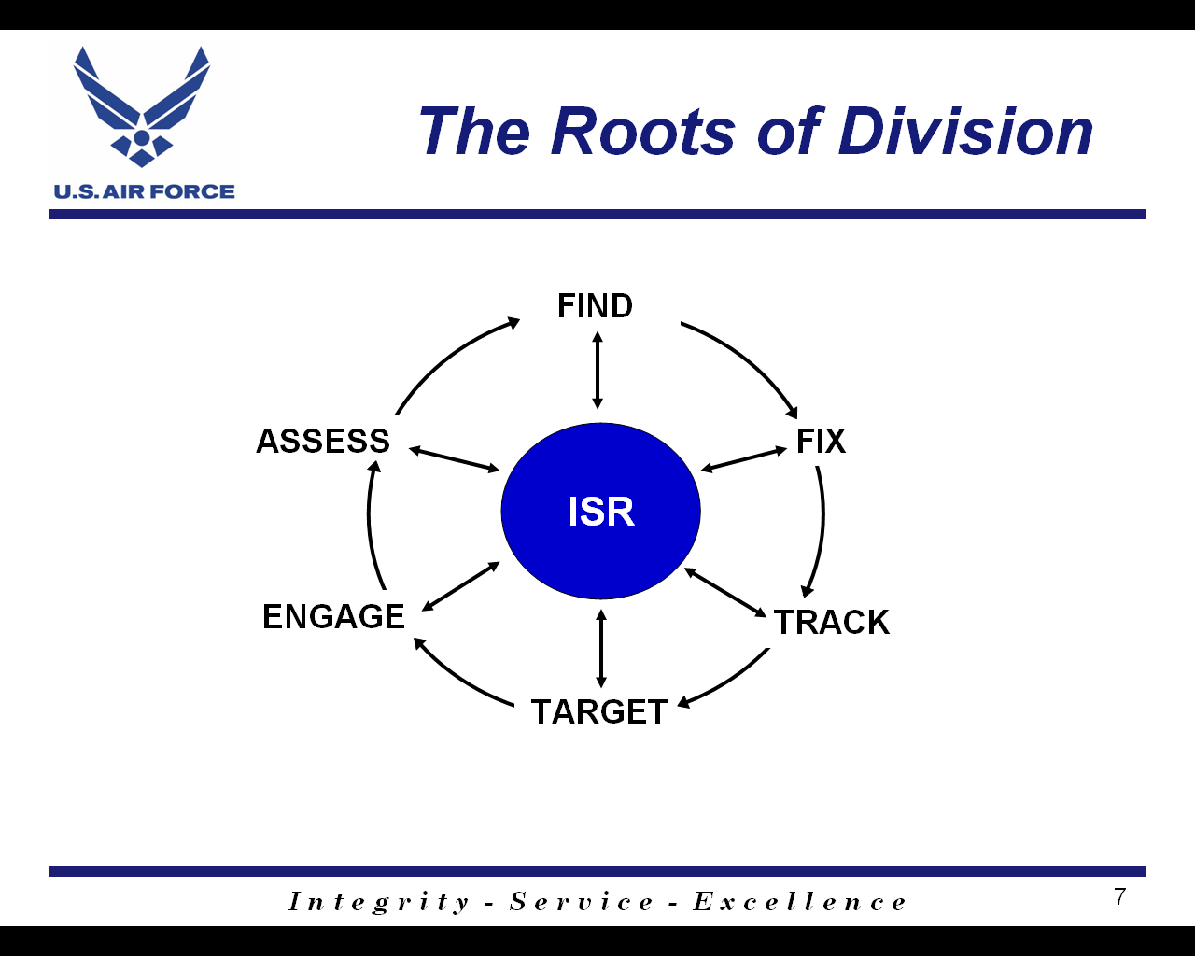
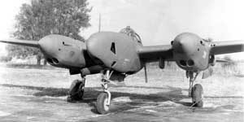




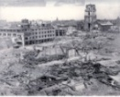

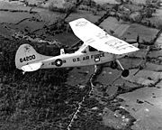




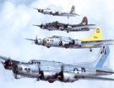

Info in War Revolution
Technology—Information—Organization
“Recce” P-38
“Recce” P-38
RF-101 Voodoo
I
I
?
S
R
ISR
S
R
0-2 Bird Dog
B-17
Spotter Corps
B-52
0-2 Bird Dog
<10 Minutes
14 Days
75 Days
Number of Weapons
Required to Target
Number of Sensors
Required to Target
1943
2009
Evolution of Technology, Information, and Culture Enabled Move from Segregation of Ops and Intel to Integration of Ops and Intel…

Slide 4
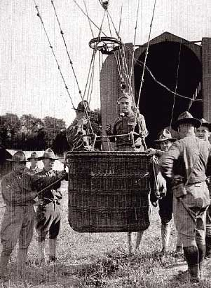
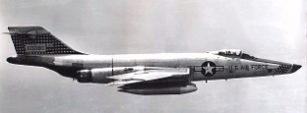
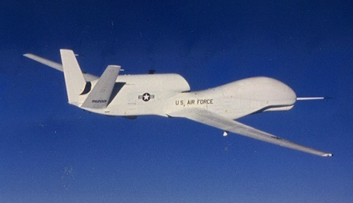

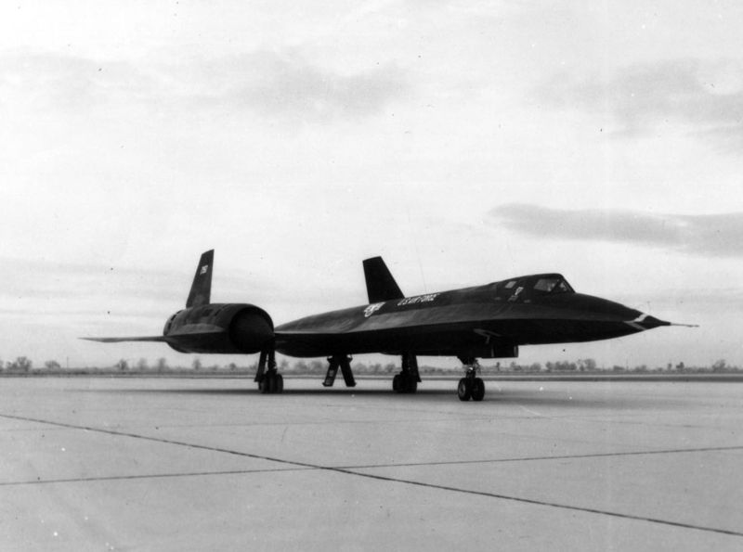
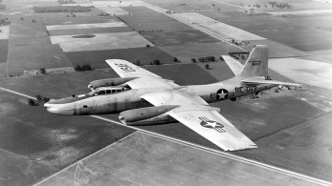
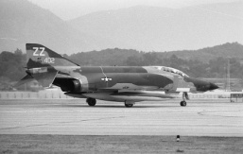
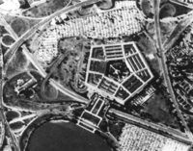
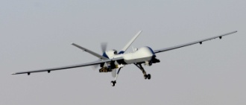
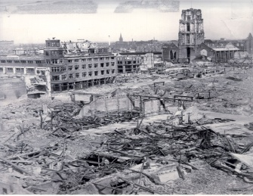
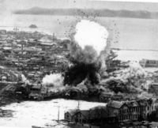
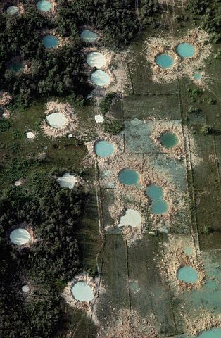
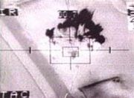
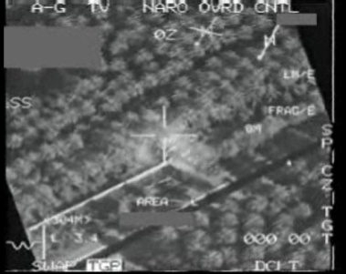
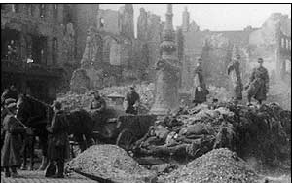
20th Century Warfare
A cultural divide of precision and information
WWII: Lockheed “Recce” P-38
Vietnam: RF-101 Voodoo
Cold War: Space
Today: GLOBAL HAWK
Cold War: SR-71
WWI: Recon
Balloon
Vietnam: RF-4C
Korea: N. American RB-45J
Today: REAPER
Finding, Fixing Tracking …
Targeting, Engaging , Assessing...
WWII : Berlin, GE
Korea: Seoul
Vietnam
Desert Storm
Iraqi Freedom: Zarqawi
WWI : Verdun, FR
21st Century challenges demand a new approach …
Notes:
4

Slide 5





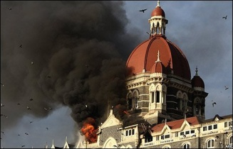


Non-Traditional Threats
Mass disruption & destruction no longer the purview of nation-states…
Irregular
Catastrophic
Highly flexible adversaries:
  Cohesive units without a “chain of command” …
  Able to act quickly …
  Modern technology …
  Driven by a cause …
  Small numbers …
  Dispersed & distributed …
Disruptive
Technologies
Mumbai, India Attack: 26-29 November, 2008
Islamabad Marriott Bombing: September 20, 2008

Slide 6

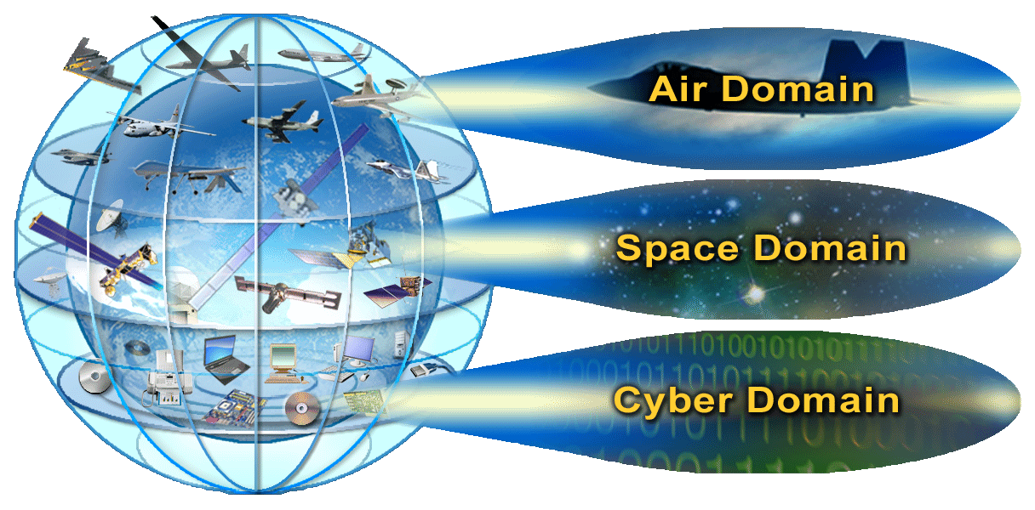
Traditional Threats
Cross Domain Dominance Challenged At All Levels

Slide 7
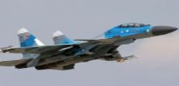
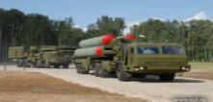
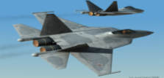










Security Challenges :
A Myriad of “What Ifs”
Near-term
Mid-term
Long-term
Near-term
Mid-term
Hybrid 4th Gen+ Fighters
SA-20 Proliferation
Advanced DRFM
Long Range AAMs
SA-21
AIR
Chinese Manned Space Program
Revitalized Russian Mil Space Program
SPACE
Emerging ASAT
Capability
High-Performance Computing
CYBER
Nanotechnology
Biometrics

Slide 8
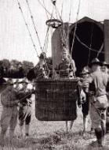






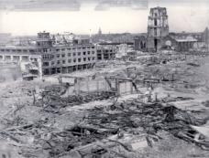
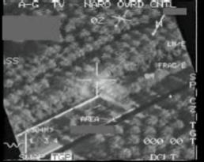
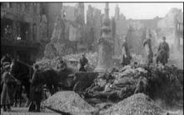
21st Century Challenges:
Precision and Information Synergy
WWII: Lockheed “Recce” P-38
Vietnam: RF-101 Voodoo
Cold War: Space
TODAY: GLOBAL HAWK
Cold War: SR-71
WWI: Recon
Balloon
Vietnam: RF-4C
Korea: N. American RB-45J
TODAY: REAPER
… Information in War: Finding, Fixing, Tracking…
INDUSTRIAL AGE WARFARE
INFORMATION AGE WARFARE
… Precision in War: Targeting, Engaging, Assessing…
WWII : Berlin, GE
Korea: Seoul
Vietnam
Desert Storm
Iraqi Freedom: Zarqawi
WWI : Verdun, FR
The most important skill Airman will need in the
21st Century is the ability to rapidly acquire,
develop, and share information across the Joint Force, and at all levels of warfare
The most important skill Airmen will need in the 21st Century
Is the ability to rapidly acquire, develop, and share
Information across the Joint Force, and at all levels of warfare

Slide 9
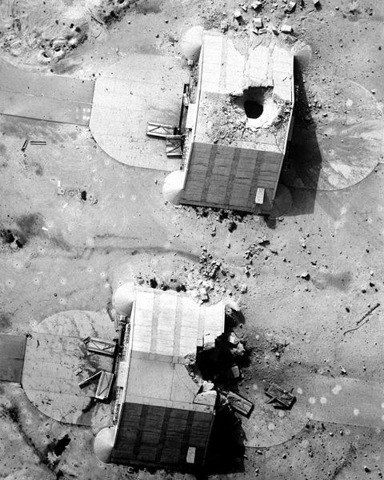




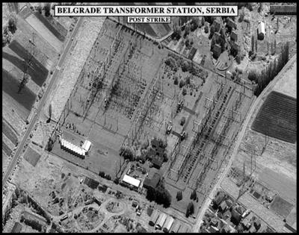
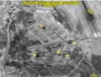



21st Century Challenges:
Precision and Information Synergy
Strategic
AIR
Strategic
Operational
Tactical
Strategic
Operational
Tactical
Strategic
Operational
Tactical
National
SPACE
Operational
CYBER
Tactical
Tactical
DESERT
STORM
1991 & Prior
1999
ALLIED
FORCE
2001
ENDURING
FREEDOM
2009
AF/PAK & Iraq
TODAY
INFO AGE
WARFARE
TOMORROW
Segregated
Intel & Ops
Ops …
+ Intel
I + S&R
ISR
GLOBAL
INTEGRATED ISR
OPS
Kandahar
Runway
NTI
Multi-Domain
Fusion
Real-Time
Fusion
INTEL
Pod Recce
9
Notes:
9

Slide 10

Tenets of AF ISR
21st Century Change
Operations: ISR is no longer support to operations,
ISR is operations
Domain neutral: ISR operates in ALL domains — Land,
Sea, Air, Space, Cyberspace
Synchronization & Integration: Inherent in ISR—we do
“S & R” to get “I,” and the only way we get “I” is thru “S & R”
Capabilities & Effects: Moving away from planning and
managing by program elements, to ISR capability areas
ISR – The center of America’s asymmetric advantage

Slide 11
21st Century Challenge
Air Force ISR Transformation
VISION:
Transform AF Intelligence, Surveillance and Reconnaissance (ISR) into a set of premier military intelligence organizations; with the most respected personnel; and the most valued ISR capability
APPROACH:
  ORGANIZATION: Optimize presentation of Air Force ISR capabilities to other service, joint, & national users
  PERSONNEL: Develop senior Air Force ISR leaders ready for 21st Century information age warfare
  CAPABILITY: Plan, guide, and orchestrate Air Force ISR from a capability-based perspective
Creating an ISR enterprise where the source is transparent,
analysis is predictive, and distribution is immediate
11

Slide 12
AF ISR Transformation:
Organization
AF ISR re-organized as an AF-wide enterprise
  AF/A2 designated as Deputy Chief of Staff for ISR …not just Intel
  AF ISR Agency (formerly AIA) established Jun 07; aligned as an AF-wide Agency to address air, space, and cyberspace ISR
  AF Distributed Common Ground Systems (DCGS) re-aligned
    Global organization matched to its global net-centric ISR fusion capability while retaining regional (MAJCOM) direction
  Created ISR Groups combining Cryptologic and DCGS capabilities under direction of Component-Numbered Air Forces
All aimed to expand ISR as an AF-wide enterprise providing
MAJCOMs & COCOMs more ISR access than ever before
12
Notes:
12

Slide 13
AF ISR Transformation:
Personnel
Officer: Seeing results – 1st AF COCOM J2 in 8-years
  Expanded number of AF ISR General Officers
  Establishing better career paths from Captain to Colonel
Civilian: Path for HQ AF, Joint, National opportunities
  Codified a consistent career progression trajectory where none had previously existed
Enlisted: Continuing to shape Enlisted transformation
  Increasing UAS, DCGS manning (~2500); parallels rising mission
  Streamlined specialties from 36 to 14..better 21st Century posture
  Stood Up new Targeting, ISR Ops, Analysis/Fusion courses
  New “Intel Master Skills Course” for Senior NCOs
ISR career paths to match 21st Century Demands …
13
Notes:
13

Slide 14
AF ISR Transformation:
Capabilities
AF ISR Strategy: defines AF ISR guidance, approach, goals
AF ISR Flight Plan: identifies options for executing the strategy
  AF UAS Flight Plan specifying AF UAS ways, means, ends
Theater ISR CONOP: provides a joint ISR methodology
ISR center of excellence established at Nellis
Established AF HUMINT for service-specific requirements
Increased ISR capabilities in accelerated time frame
  From 5 x medium-altitude UAS CAPs in 04 to 38 today…
  Transitioning to all MQ-9 force; 22/44X more cost-effective than MQ-1B/C: WAAS development…10 times today’s images per platform starting in FY10 going to 65+
  Project Liberty: MC-12W with FMV & SIGINT
    Less than 7 months from contract to delivery
Unified planning to integrate ISR capability development
14
Notes:
14

Slide 15
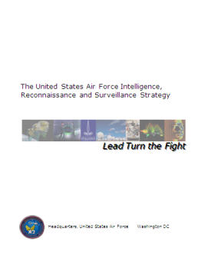
AF ISR Strategy
Lead Turning the Fight
Introduce future security environment
  The next 20 years will not look like the last
  Constant friction of disruptive technologies
  Need for anticipatory vice reactive ISR
Strategy seeks organization to integrate the ISR enterprise as a cross-domain function
  AF ISR previously consisted of separate elements in separate commands operating in separate domains
Shifts human location from platforms to global architectures
  Access ISR operations and analysis via reachback
Creating an ISR enterprise where the source is transparent,
analysis is predictive, and distribution is immediate

Slide 16
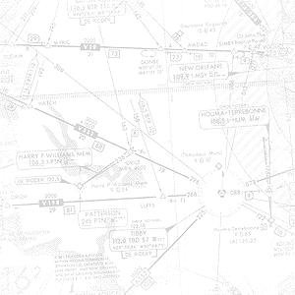
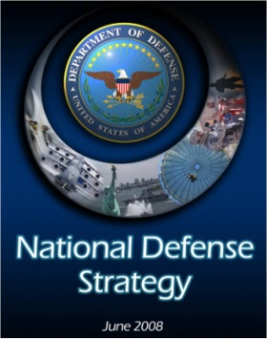
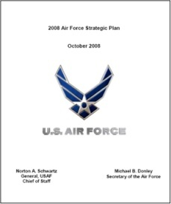
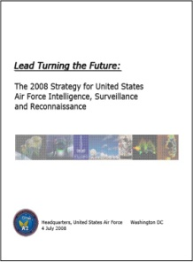
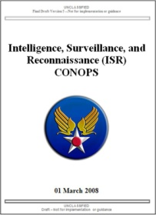
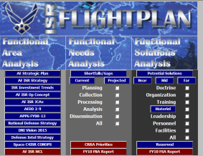

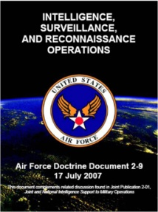


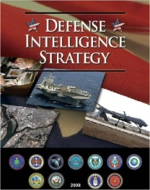
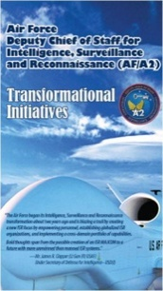
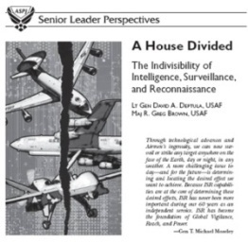
AF ISR Flight Plan
Resourcing the Strategy
Assessment “Way Points”
Air Force ISR
FLIGHT PLAN
Lead Turning the Future
ORGANIZATION
PERSONNEL
MATERIEL
ISR Flight Plan
Database inventory of ISR capabilities; present, planned, and future
Ongoing identification of shortfalls
Direct access to COCOMs & MAJCOMs to input requirements
Steering document and “Strat-to-Task” process to drive
ISR capabilities from strategy to requirements to funding
Notes:
16

Slide 17
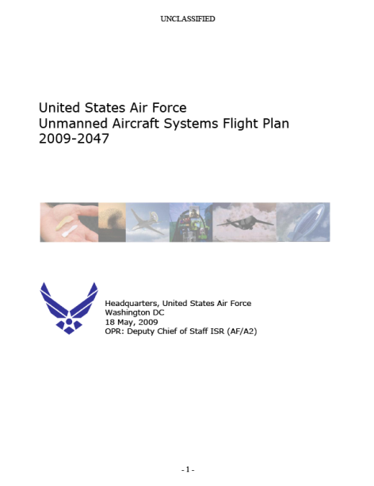
AF RPA Flight Plan:
Vision for an remotely piloted future
An Air Force with…
Remotely piloted aircraft that are fully integrated across the full range of military operations
RPA that use automated control and modular “plug-and-play” payloads to maximize combat capability, flexibility and efficiency
Joint RPA solutions and teaming
An informed industry and academia – knowing where we are going and what technologies to invest in
Capabilities-based Air Force RPA vision thru 2047

Slide 18
RPA Growth in AF Core Functions/Capabilities
Legend
Core Functions (Ways) | Capabilities (Means)
Nuclear Deterrence | Ballistic Missile Defense
Air Superiority | Electronic Warfare | Suppression of Enemy Air Defenses | Air-to-Air Superiority
Space Superiority | Space Force Enhancement | Space Support (including launch support) | Space Force Application
 | Space Control
Cyberspace Superiority | Network Warfare Operations | Network Operations | Forensic Analysis
 | Influence Operations | Space Control (Negation)
Command and Control | Connectivity | Information Integration | Theater Planning & Execution
Global Integrated ISR | Collection | Plan & Direct ISR Activities | Analysis and Production
 | Process and Exploitation | Dissemination
Global Precision Attack | Close Controlled Strike | Long Range Strike | Intra-theater Strike
Special Operations | Specialized ISR | Aviation FID | Battlefield Air Operations
 | Specialized Aerospace Fires | Information Operations | Specialized Air Mobility
Rapid Global Mobility | Airlift | Air Refueling | Aeromedical Evacuation
Combat Search and Rescue | Humanitarian Assistance Ops | CSAR | Civil SAR
 |  |  | Disaster Response
Agile Combat Support | Employing the Force | Positioning the Force | Recovering the Force
 | Sustaining the Force | Preparing the Battlespace | Readying the Force
Building Partnerships | Strengthen Relationships | Assess
 | Train, Advise, Assist | Obtain Support for US Interests
Currently Supporting
Near-term shortfalls
Long-term potential

Slide 19
AF RPA Flight Plan:
Function Areas
Today
Current
Capability
Shortfalls
EA
GAP
Nano
Indoor recon, indoor lethal/non-lethal, indoor comm, cyber attack, Swarming
NANO/MICRO
WASP III
Personal ISR, Lethal, SIGINT, Cyber/EW, Counter UAS, Auto-sentry
Family of Transformers
Small
Raven
NextGen – Multi-Mission
ISR, Comm Relay, Lethal/Non-lethal, Cyber/EW, SEAD, SIGINT, Low Altitude Pseudo-Sats
Scan Eagle
Tier II STUAS
ISR, Comm Relay, Lethal, SIGINT
Air-Launched SUAS
Close-in ISR, Lethal, SIGINT/DF
MQ-1B
Fighter
Recap
Medium
“fighter size”
MQ-9
EA/ISR/CAS
SEAD/AAR-T
Counterair, Missile Defense
MQ-Ma
MQ-Mb
MQ-Mc
EO/IR/SAR
Large Aircraft
Recap
RQ-4 Blk 10/20
MP-RTIP
Large
“tanker size”
RQ-4 Blk 30
RQ-4 Blk 40
RJ/E-X
C/KC-X
NGLRS
+ASIP
MQ-La
MQ-Lb
MQ-Lc
Interoperable UAS C2
Special UAS
High Altitude Long Endurance
ISR/EA
Low Observable
Hypersonic
FY09 FY47

Slide 20
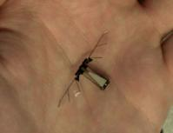

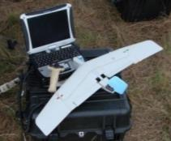



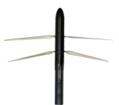


AF RPA Flight Plan:
Small “Family of Systems”
Bio-Mechanicals
- Indoor Reconnaissance
- Indoor Lethal
- Indoor Comm
- Cyber attack
Nano
Navigate / communicate inside buildings
Bio-Mechanicals
- Indoor Reconnaissance
- Indoor Lethal/Non-lethal
- Indoor Comm
- Cyber attack
- Swarming
Nano
“SUAS Family of Transformers”
- Personal ISR
- Lethal
- SIGINT
- Cyber/EW
- Counter-UAV
- AutoSentries
Micro
Close-in reconnaissance & situational awareness
Wasp III
Lite Machine’s
Conceptual SUAS
Man-portable
- ISR
- Time-Sensitive
- Lethal
Irregular Warfare
Family of Expendables
- Close-In ISR
- Expendable Jammers
- Lethal
- Counter Air
- Precision Clandestine Resupply
- Cyber attack
Raven B
Artist
Conception
Future AL-SUAS
Increasing across all mission sets
Switchblade SUAS
Technical Demonstration
Air-Launched
- Close-in ISR
- Lethal
- SIGINT/DF
Anti-Access Support
Voyeur SUAS
Technical Demonstration
Next Gen Multi-Mission
- ISR
- Communications Relay
- Lethal / Non-lethal
- Electronic/Cyber Attack/SEAD
- SIGINT/Low Altitude Pseudo-Sats
= New Mission areas
Finder
SUAS
Multi-Mission
- ISR
- Force protection
- FID
Tier II Joint
- ISR
- Comm Relay
- Lethal
- SIGINT
Scan Eagle
GT Aero
Conceptual Bandit SUAS
Now Future
20

Slide 21



AF RPA Flight Plan:
Medium Systems
EW/ISR
CAS
EW
Comm Relay
ISR
Collection
CAS
Dissemination
Comm Relay
Specialized ISR
Modular Payloads
Modular Payloads
MQ-1
- Collection – SIGINT/FMV
CAS
Collection
AAR-R&T
MQ-Xa
Dissemination
SEAD
Specialized ISR
MQ-Xb
Air Interdiction
AAR-R
Counter Air
CSAR
Missile Defense
MQ-9
- Collection – SIGINT/FMV
CAS
Strategic Attack
MQ-9
Collection
  SIGINT/FMV
  Wide Area Airborne ISR
  SAR/GMTI
CAS
MQ-Xc
EW
ISR
CAS
Comm Relay
Collection
Dissemination
Modular Payloads
Specialized ISR
AAR-T
SEAD
Air Interdiction
Aeromedical Evacuation
Personnel Recovery
Now Future

Slide 22







AF RPA Flight Plan:
Large Systems
EW
ISR
MQ-Lc
Command and Control
Airborne Moving Target Indicator
Ground Moving Target Indicator
Information Integration
AAR-R & T
Modular Payloads
RQ-4 (Blk 20/30/40)
Collection:
Block 20
  Enh SAR
  Enh EO/IR
Block 30
  Adv SIGINT
Block 40
  MP-RTIP Radar
  GMTI and concurrent SAR
  High Range Resolution
  No EO/IR or SIGINT
Airlift
Humanitarian Assistance
Strategic Attack
Global Strike
CAS
Air Mobility
RQ-4 (Blk10)
Collection – ISR
  Basic SAR
  Basic EO/IR
Airlift
MQ-Lb
EW
ISR
Command and Control
MQ-La
Airborne Moving Target Indicator
EW
Modular Payloads
Ground Moving Target Indicator
ISR
Information Integration
Command and Control
AAR-R & T
Modular Payloads
Airborne Moving Target Indicator
Airlift
Ground Moving Target Indicator
Humanitarian Assistance
Information Integration
AAR-R
Now Future

Slide 23
21st Century Challenges:
A new emerging problem set
Analysts overwhelmed by “data crush”
Analysis and exploitation tools not keeping pace with sensor development and deployment
“Copy & Paste” approach to ISR fusion becoming the “norm”…revealing new ISR information becoming rare
“Hunt and not Gather” mentality pervasive in ISR operations…few resources and tools available to “cast-the-net” approach to analysis and fusion
Swimming in sensors… Drowning in Data…

Slide 24




Wide Area Airborne Surveillance (WAAS)
MQ-9 advantages over MQ-1
2 x faster – more responsive
2 x higher – broader coverage
10 x payload (versatile: sensor, weapons)
FMV – 30 fps
Gorgon Stare – 2 fps
Gorgon Stare + ARGUS
Gorgon Stare
FMV
MQ-9
10x10 km coverage area
As many as 30 ROVER queries
and potentially 65 clips to the
Tactical Operations Center
MQ-9
4x4 km coverage area
12 independent ROVER queries
growing to 30
MQ-1
Observe single target
Single ROVER / OSRVT
Today
IOC 2nd Qtr FY10
4th Qtr FY11

Slide 25

Why “CAPs” Should Not Be a
Measure of ISR Sufficiency

Slide 26

21st Century Challenges:
AF ISR Distributed Operations
Deployed ISR
Entire AF ISR
Enterprise
Approximately 1100 ISR Airmen deployed—however, more than 5,000 Airmen executing ISR operations for the COCOMs every day
Minimizing forces deployed forward allows
us to project power without projecting vulnerability...
26
Notes:
26

Slide 27














Domains & Environments:
A cautionary note…
REGULAR
IRREGULAR
CATASTROPHIC
DISRUPTIVE
AIR
SPACE
CYBERSPACE
GROUND
MARITIME

Slide 28
Domains & Environments:
A cautionary note…
PERMISSIVE
CONTESTED
DENIED
AIR
SPACE
CYBERSPACE
GROUND
MARITIME

Slide 29


Challenges to Aerospace Dominance
Threats to aerospace capabilities are rapidly growing as a result of
advanced technology and learning from US operational successes
Threats to aerospace capabilities are rapidly growing as a result of advanced technology and learning from US operational successes
Long Range SSMs
… adversaries will attack us in every
domain, at every phase
Advanced Cruise Missiles
Advanced Sensors/Radars
Long Range /More Lethal SAMs
BVR AAMs
EW: DRFM/Jamming
Space Attack Assets
Cyber Attack
The future threat environment will not be like that
we have seen in the past …

Slide 30





America’s Asymmetric Advantage… Ops From the Third Dimension
“Tanks And Armor Are Not a Big Deal...The Planes Are The Killers. I Can Handle Everything But The Jet Fighters”
- Conversation Between Taliban Field Commanders 2008
“The drones are very effective ...[in attacking us]
- Taliban Field Commander 2009

