Slide 1
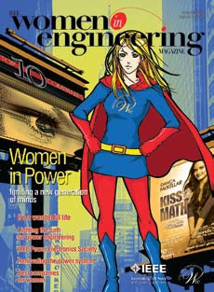
Women in Engineering
and the Media
Leslie Sue Lieberman, Ph.D.
Professor of Anthropology
Courtesy Prof. Medical Education
Director, Women’s Research
Center- UCF
http://womens.research.ucf.edu
2010 IEEE Women in Engineering Magazine
www.ieee.org/ieeemedia
Florida AAUW Annual Conference 2010

Slide 2
Background: Critical Need
Concern: Maintaining US Science and Technology Leadership - National Academy of Sciences, National Academy of Engineering, Institute of Medicine
Employment in science and engineering will increase about 70% faster than the rate of all other occupations
Need: 160,000 more engineers in 2016
Workforce approximtely 60% women but only 12% of the S&E workforce are women

Slide 3
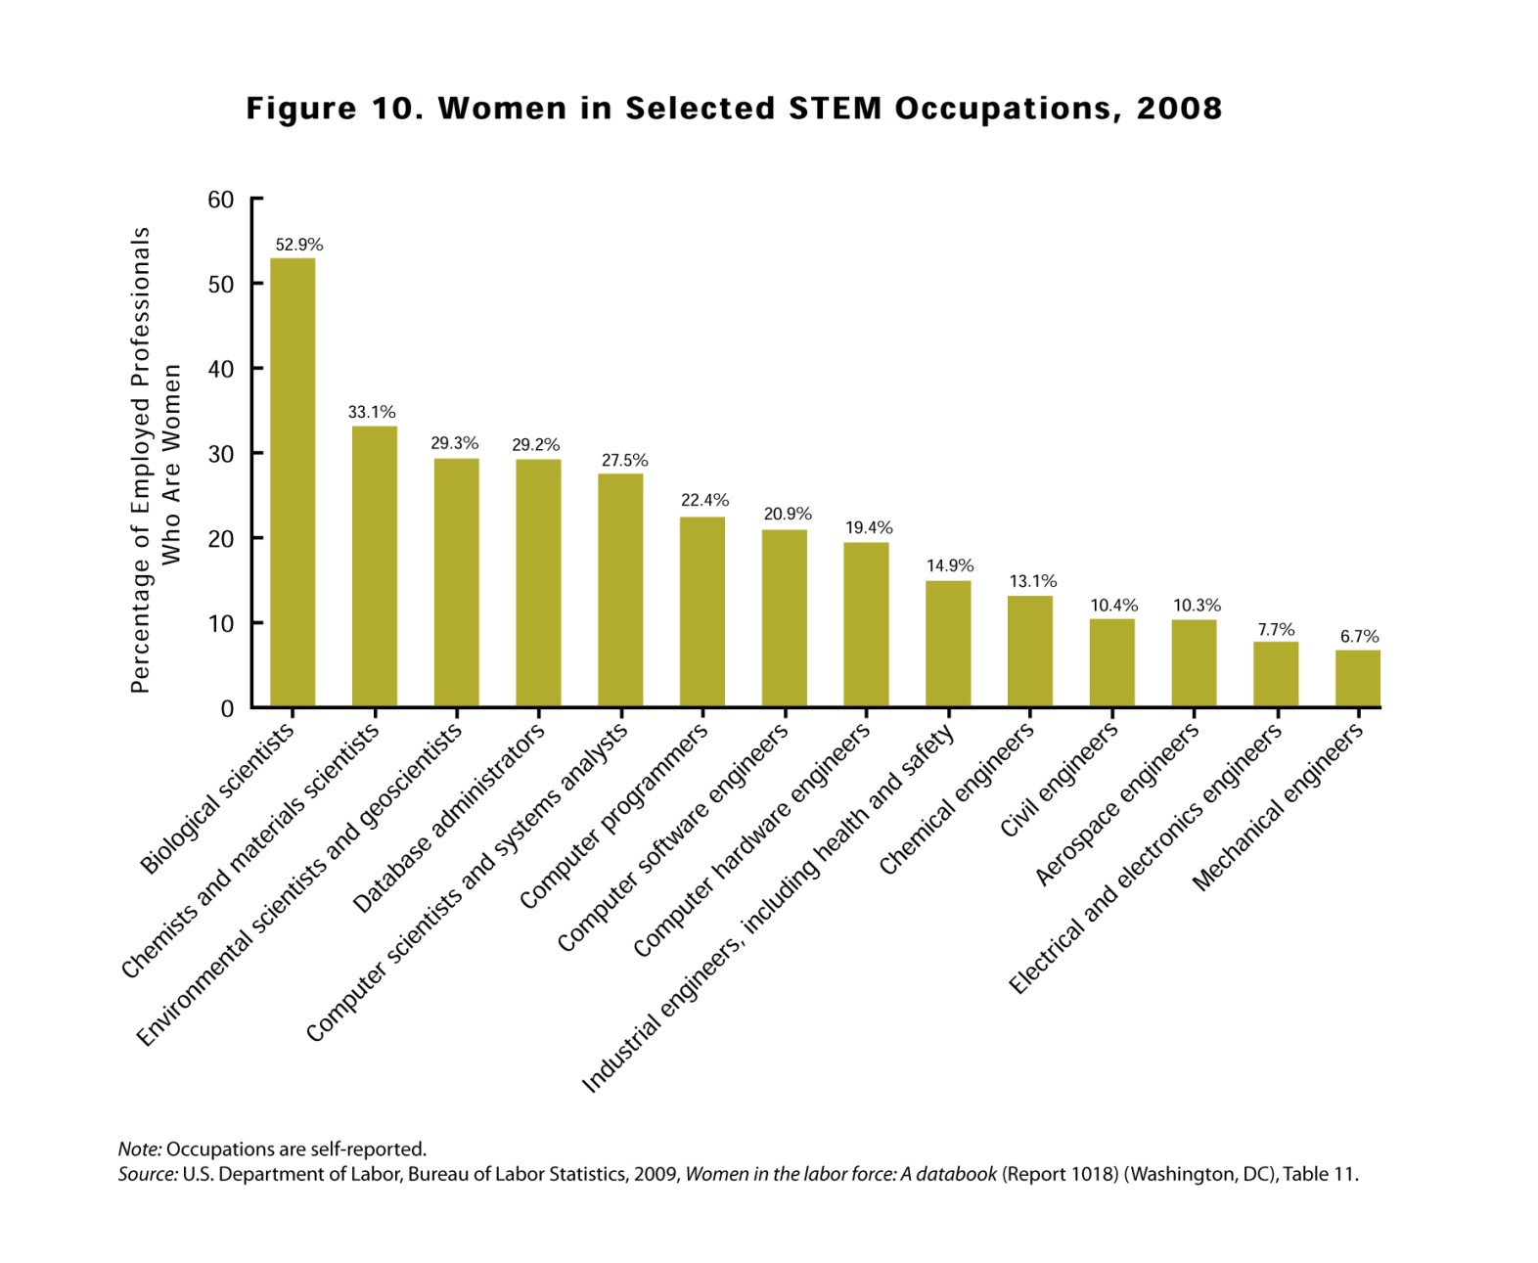

Slide 4
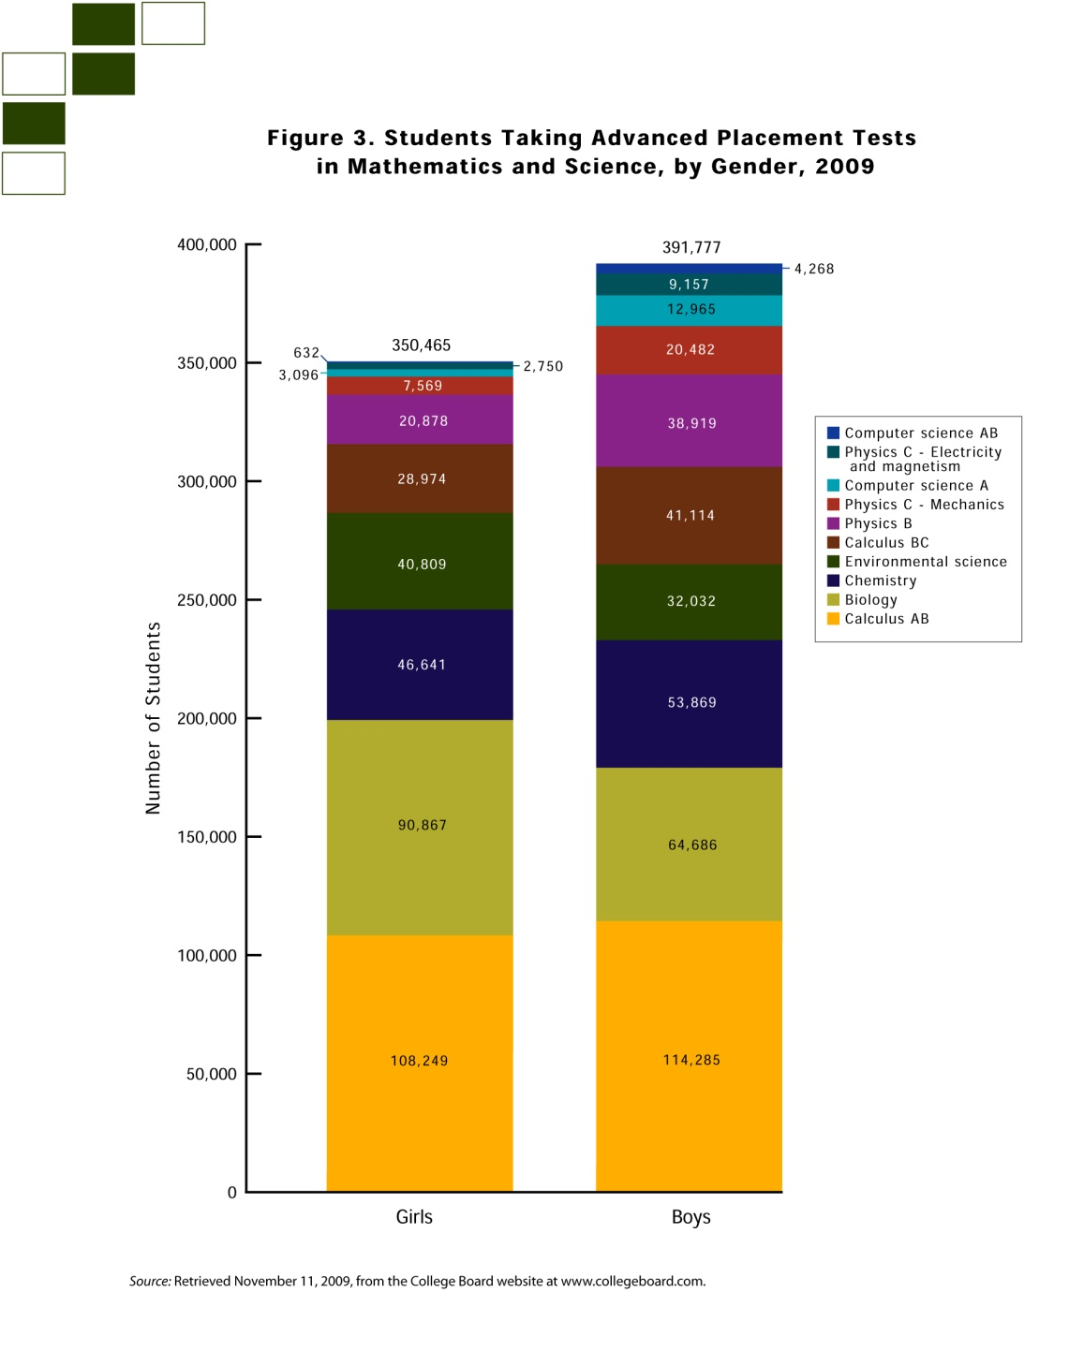

Slide 5
Undergraduate Females and Males in Engineering

Slide 6
Problems
Low enrollments in STEM majors-flat or declined in the last 10 years
High job attrition - 21% start but by age 35-40 52% “drop out”
Sexual harassment (2/3rds of college women in AAUW 2006 report; UCF 2006-7 study) and glass ceilings (UCF 2007)
“Hard Hat”, “Lab Coat” and “Geek” cultures are not women-friendly
Public perception of engineering & engineers are not favorable and not women-friendly; biased, gender schemas, stereotyping

Slide 7
Responses
Outreach-Education-Transformation
Strengthen math & science education - teachers, students
Provide incentives to go into the STEM disciplines and for innovative research; scholarships, science fairs, university programs
Informal science education programs - clubs, summer camps, EYH, Girl Scouts, NGCP

Slide 8
Responses
Outreach-Education-Transformation
Professional Societies - IEEE, SWE, ACM; WEPAN, AWIS other organizations
Corporate women’s alliances; women and family-friendly policies, summer internships
Campus - student recruiting, mentoring, clubs, faculty mentoring
National - NSF ADVANCE grants; research support programs; STEM ed.; National Engineers Week

Slide 9

National Academy of Engineering
Committee on the Public Understanding of Engineering Messages
(BBMG/GSG)

Slide 10
Public Perceptions of Engineering and Engineers
Engineers are good at math and science
Engineers work hard (but are not nerds)
Engineering solves problems
Engineers design, build and construct things
Yet, not rated highly as a profession- right between “Farmer” and “Member of Congress”
No ‘public face’ of engineering- there are no famous women engineers

Slide 11
What do High-School Girls think about Engineering?
HS girls believe engineering is for people who
love math and science
Engineering is perceived to be a man’s
profession
HS girl’s interests hinge upon relevance
There are no role models – no famous women
engineers and few in universities and
corporations

Slide 12
Career and Academic Motivators for Girls
Messages Girls Hear about Engineering
Enjoyment of one’s work or studies
Good working environment
Making a difference
Good Income
Flexibility
A challenging career
Difficult but rewarding
Using math and science to solve problems
Figure: Differences between known motivators for career choices by girls and message from the engineering community

Slide 13
Public Perceptions of Engineering and Engineers
NEW POSITIONING STATEMENT
Spirit of innovation-bold new solutions
Research with real-world applications
Direct and positive effect on people’s everyday lives
Will meet the needs of the 21st century & shape the future

Slide 14
Preliminary taglines selected as “very appealing” by teens, by percentage.

Slide 15
This is Engineering
Video and Media Website
Released February, 2010
National Engineers Week
See this on our WRC Website or YouTube

Slide 16
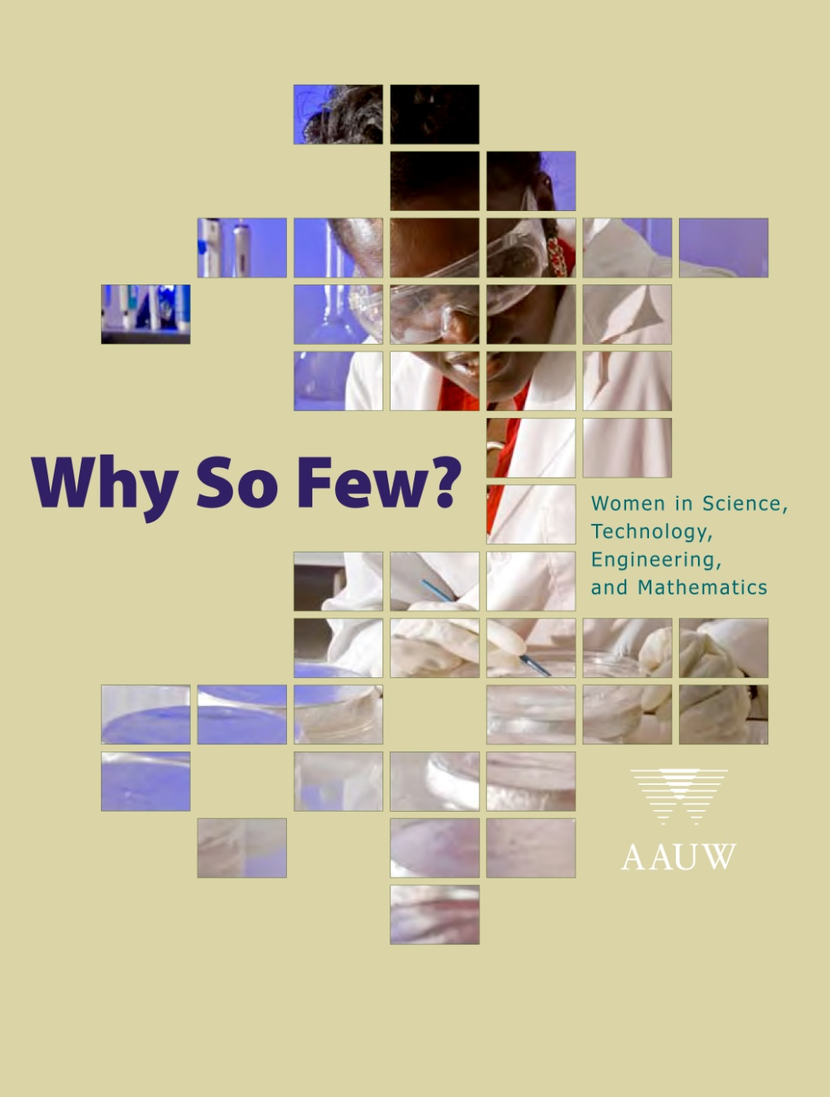

Slide 17
GENERATION Y (Age 10-32)
What They Say
“Anyone can be a star …”
“Everyone deserves to have her say.”
“Getting heard and having a say are
not only easy, they seem natural”

Slide 18


Slide 19




They watch CSI, HOSPITAL, COMEDY,TALK SHOWS and REALITY TV.
TV is not passive entertainment .
It is an interactive experience!
Their lives and outlooks have been shaped by it.

Slide 20

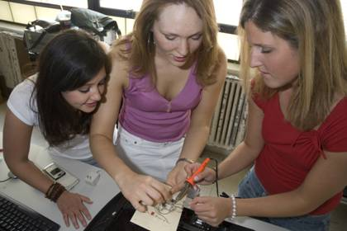
http://www.nerdgirls.org
Reality Videos
Merchandise
Media Presence- Print, TV,
Website

Slide 21
Why a TV Drama?
TV and Internet Reality Programs- “Engineer Girl”, “Extreme Engineering”, “Design Squad”; books; games, podcasts
177 Companies spent $400M – not focused, not effective
SUCCESS of the CSI genre Programs
70-90% forensic science students are women
SUCCESS of STEM recruitment in other countries (PAWS in the UK, EuroPAWS)

Slide 22
Why a TV Drama?
Large-scale coordinated effort – 30-60M viewers each week for individual programs
Reach diverse key audiences- middle school through college, parents, teachers, engineers, news media, policymakers
Achievable- “Can Do” message
TV has immense power to create positive images & challenge stereotypes
TV acts as a catalyst for change

Slide 23
Why a TV Drama?
BRANDING
Creating and delivering a consistent message, core messages
Image of women engineers & TV is a visual language
Experiences of women engineers in work & non-work lives

Slide 24
Why a TV Drama?
Addressing the Issues In Why So Few?
Math-based myths: performance expectations & ‘stereotype threat’
Spatial abilities- can be learned
Role model expectations: the more competent, the less well-liked = no promotion
Broad concepts of what is engineering
Work-Life Balance: causes of dropout from the workforce

Slide 25
E-Girls in O-Town
TV Pilot
“The Power of One”
A bomb scare, an incompetent boss, annoying employees and media criticism—a typical day for Lee Power as she leads a team of engineers armed with the knowledge that in engineering, as in life, you should never underestimate the value of failure.
Screenwriter: Mary Johnson, Ph.D.

Slide 26
“As we think about the many challenges ahead, it is important to remember that students are driven by passion, curiosity, engagement and dreams……
Why do girls become engineers--- because dreams need doing”
Charles M. Vest
“Educating Engineers for 2020 and Beyond”
Educating the Engineer of 2020

Slide 27
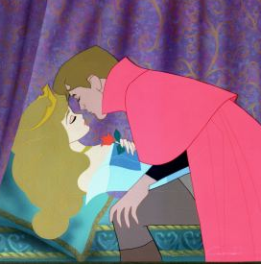
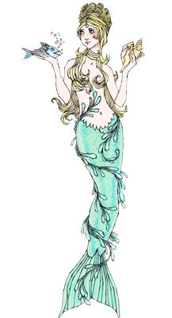
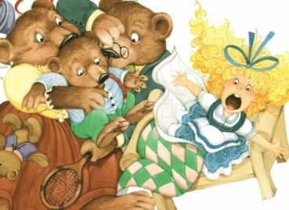
Mentoring to awaken a sleeping intellect and passion
Viewed as a bit strange and
perhaps exotic
Absolutely intrepid---to go boldly
where few women have
gone before
Fairy Tales Can
Come True

