Slide 1
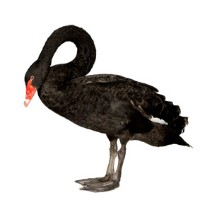
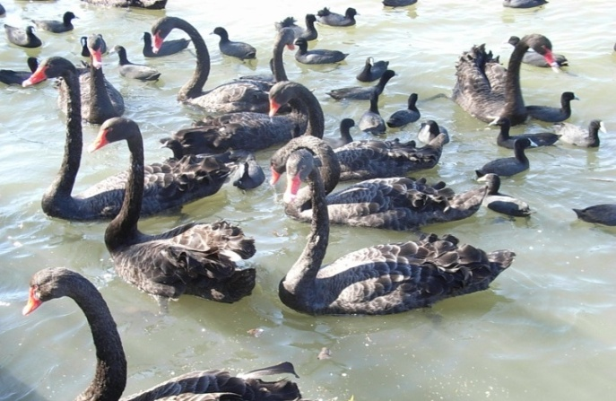
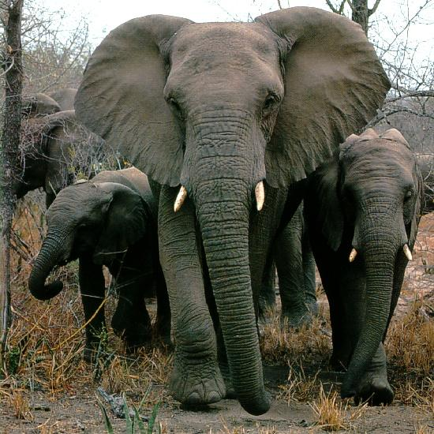
Black Swans and Elephants on the Move:
How Emergencies Impact on the Welfare State

Slide 2
What this lecture is about
An attempt to answer two questions:
How do sudden and unexpected national and international emergencies – the ‘black swans’ of war, economic depression, hyperinflation and, more prospectively and topically, mass epidemics, terrorist incidents and environmental catastrophes - affect the character of welfare state interventions and welfare state development?
Why has the contemporary literature on the welfare state so little to say about the impact of ‘black swans’?

Slide 3
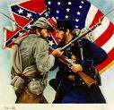
Question 1: Circa 1900, which was the world’s biggest welfare state?
High marks for Bismarck’s Germany or for Denmark, but a special award for knowing that American Civil War pensions made for a welfare state just as big in 1900, with a clientele of around a million and taking up about 40 per cent of American government spending by the end of the century.

Slide 4

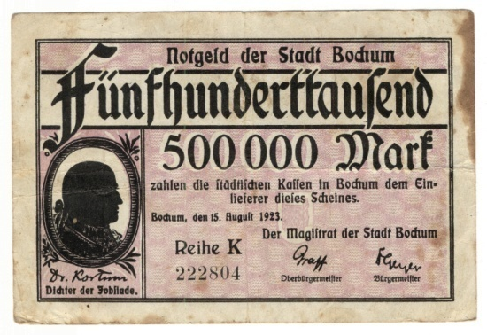
Question 2: What made West German welfare state development distinctive in the post-war period?
Learning from catastrophes – the German hyperflations of 1923 and 1948 teach the trade unions and the Left that price stability is a prerequisite for protecting incomes and savings. Creating the Bundesbank to institutionalize the lesson.

Slide 5
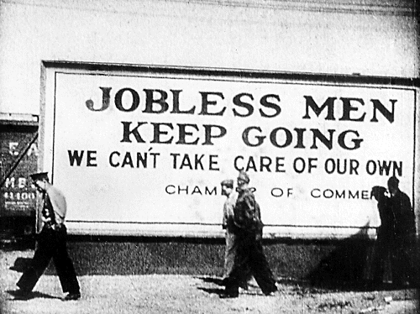
Question 3: Was the experience of the Great Depression enough to promote a commitment to welfare state expansion?
In some countries but not in others. Contrast Roosevelt’s New Deal, Social Democratic Sweden and the New Zealand Social Security Act with financial orthodoxy in Britain and Australia and authoritarian reaction in Germany, Austria and Italy.

Slide 6
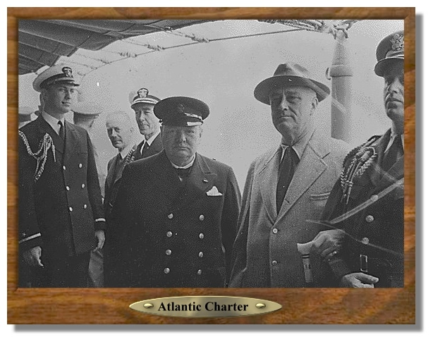

Question 4: Was World War Two the watershed event that precipitated us into the ‘golden age’ of the welfare state?
Churchill and Roosevelt agree the Allied war aims should include “improved labour standards, economic advancement and social security as well as freedom from fear and want”.
Creating the solidarities, administrative routines and tolerance of higher taxes for post-war welfare state expansion.

Slide 7

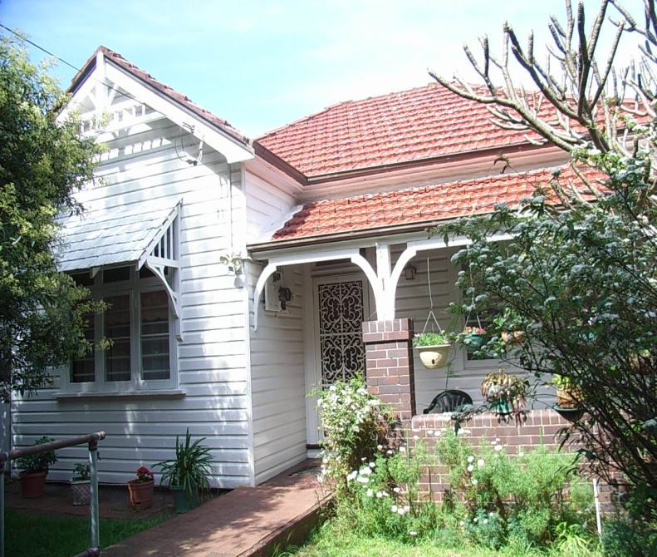
Question 5: Why, around 1980, did Australia with no state sponsored early retirement schemes have inactivity rates among older males as high as in Germany which had extensive early retirement schemes?
Joe Seddon - my father-
in-law– 1941 – North Africa
This is the house that Joe bought in 1954
Australian veterans who had served overseas were entitled to retire at 60 [rather than 65] and to highly preferential War Service home loans [just 3.75 per cent fixed over 40 years].

Slide 8
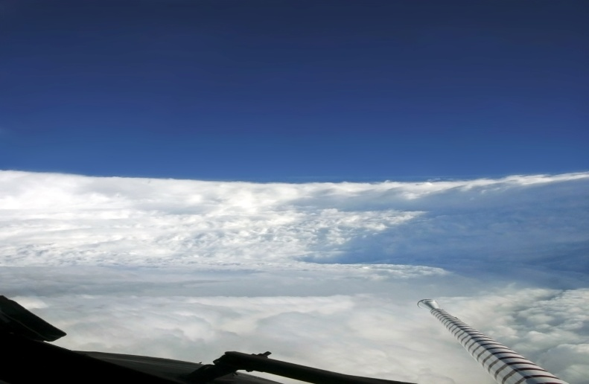
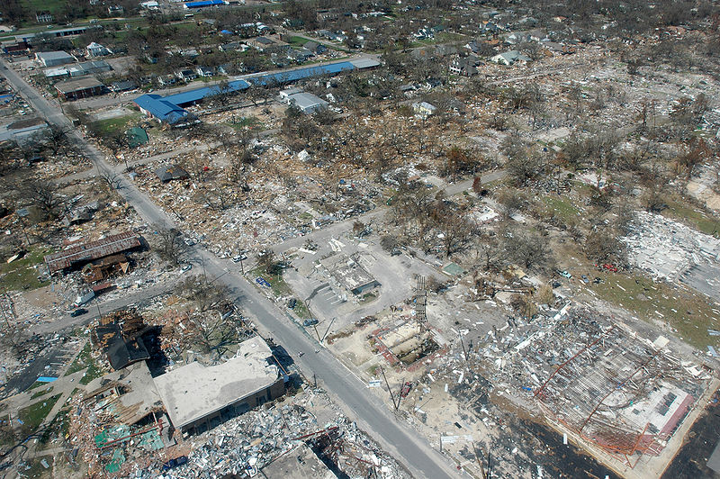
Question 1: Does the fact that an emergency event creates need automatically make it a concern of the welfare state?
Some catastrophes like Hurricane Katrina are defined as exceptional and once-off events falling within the province of institutionalized emergency services and disaster relief agencies rather than the welfare state.
The eye of the storm and what it did

Slide 9
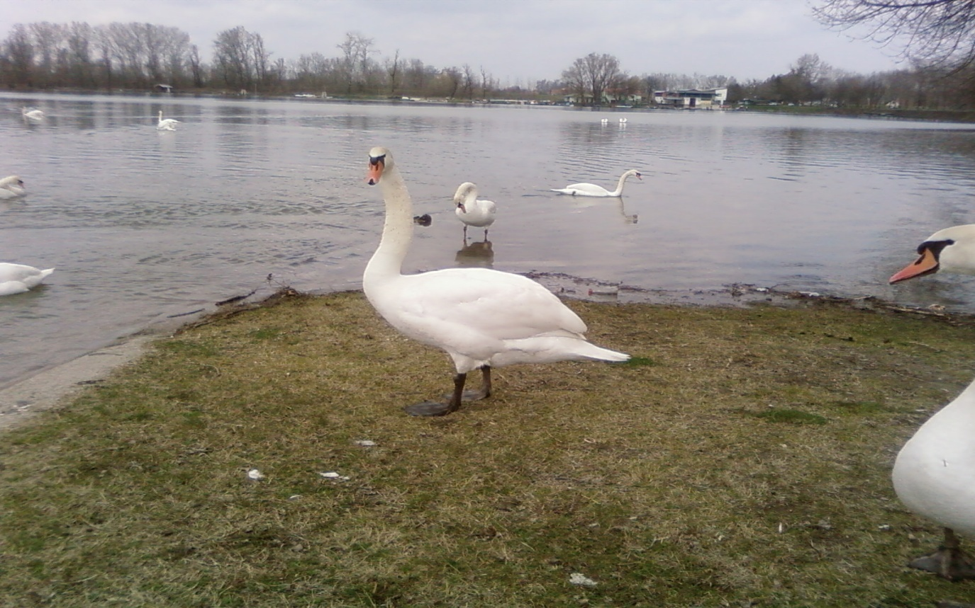
Question 2: Does the type of emergency event affect the capacity of the welfare state to deal with it?
[Welfare states deal with routine personal emergencies and predictable but only rarely occurring national emergencies, e.g. epidemics, recessions].
The unpredictability of black swans – A Eurocentric view.

Slide 10
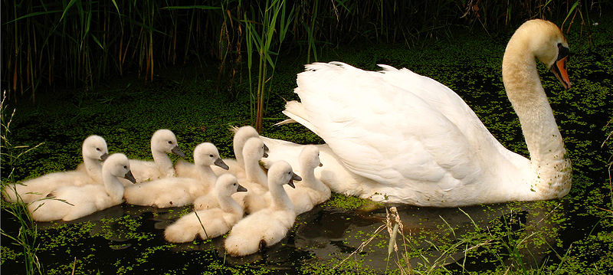
Question 3: Does the timing of emergency events make a difference to the severity of their consequences?
With time and institutionalization, responses to emergency
events become routinised and their impacts diminish.
******
Black swans become whiter and smaller.

Slide 11
Question 4: Does size matter?
The impact of a ‘black swan’ depends (a) on its size and (b) on the size of the institutional setting [i.e. the welfare state] on which it impacts. Western welfare states are hugely bigger than in the first half of the 20th Century – they are ‘elephants on the move’.

Slide 12
Question 5: Does the type of welfare state matter?
Comprehensive [Social Democratic] welfare states can include most
new needs under existing categories; insurance-based [Continental]
states have a tried and trusted repertoire for coping with new needs;
default options for Liberal English-speaking welfare states to do
nothing, use social assistance or devise specific add-on schemes].

Slide 13

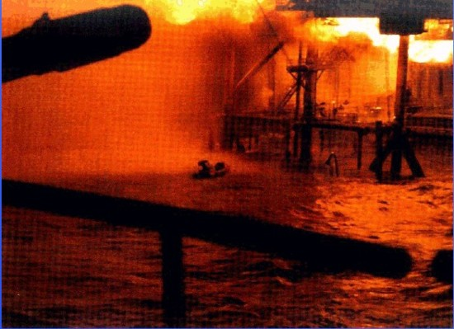
Question 6: What are the implications of this analysis for coping with future ‘black swan’ events?
“The worse, the better.”
[Attributed to V. I. Lenin, 1914].
[Motto of the RAF]
“Spin-doctors are rarely the agents of meaningful reform”.
[Frank Castles, Oxford, 7/10/2009].
[Alpha Piper – A “burning
platform” for change]
Some Lessons in Leadership or How to
Harness Black Swans to Achieve Change

Slide 14
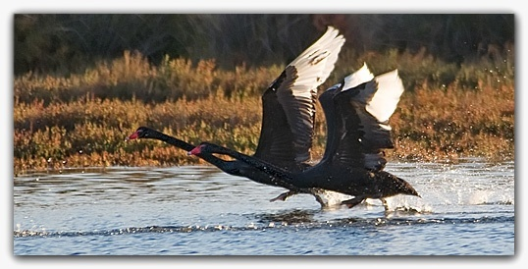
Conclusion: Where the Black Swans are Gathering
In the South, where bigger emergencies occur in small and weakly institutionalized welfare states;
In the West, where terrorism and, possibly, epidemic are greater threats than any time in the recent past;
Everywhere, if the emergencies inevitably presented by global warming are not harnessed by a more determined democratic leadership than we have seen since World War Two.

