Slide 1
Inference: significance Tests about hypotheses
Chapter 9

Slide 2
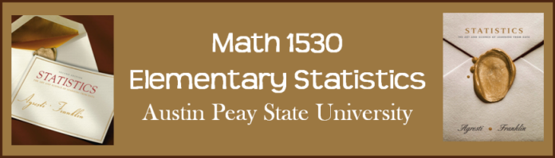
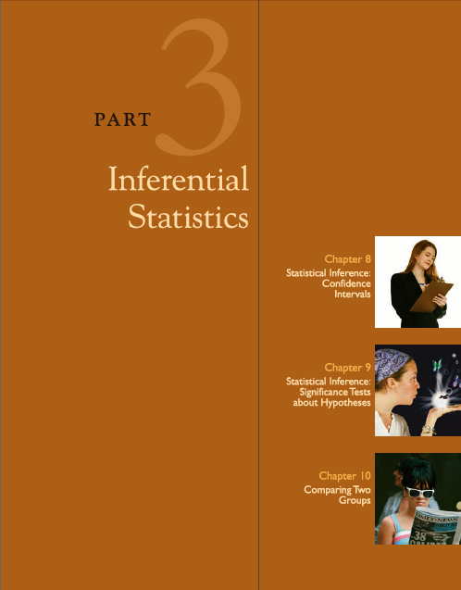
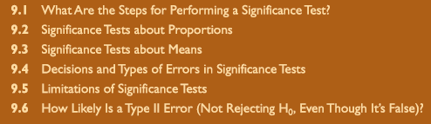

Slide 3

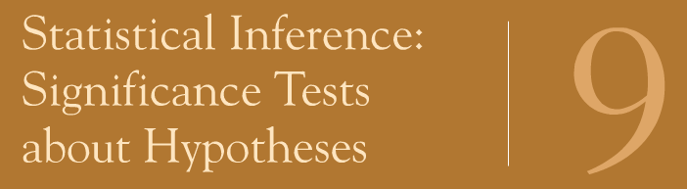
9.1: What Are the Steps for Performing a Significance Test?

Slide 4

Learning Objectives
5 Steps of a Significance Test
Assumptions
Hypotheses
Calculate the test statistic
P-Value
Conclusion and Statistic Significance
jewishmusicreport.com

Slide 5
Significance Test
Significance Test about Hypotheses – Method of using data to summarize the evidence about a hypothesis
Assumptions
Hypotheses
Test Statistic
P-Value
Conclusion

Slide 6
Step 1: Assumptions
Data are randomized
May include assumptions about:
  Sample size
  Shape of population distribution
Assumptions
Hypotheses
Test Statistic
P-Value
Conclusion

Slide 7
Step 2: Hypothesis
Statement: Parameter (p or μ) equals particular value or range of values
Null hypothesis , H_{o}, often no effect and equals a value
Alternative hypothesis, H_{a}, often some sort of effect and a range of values
Formulate before seeing data
Primary research goal: Prove alternative hypothesis
Assumptions
Hypotheses
Test Statistic
P-Value
Conclusion

Slide 8
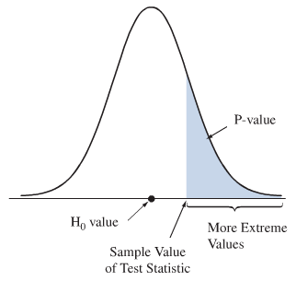
Step 3: Test Statistic
Describes how far (standard errors) point estimate falls from null hypothesis parameter
If far and in alternative direction, good evidence against null
Assesses evidence against null hypothesis using a probability, P-Value
Hypotheses
Test Statistic
P-Value
Conclusion
Assumptions

Slide 9
Step 4: P-value
Presume H_{o} is true
Consider sampling distribution
Summarize how far out test statistic falls
Probability that test statistic equals observed value or more extreme
The smaller P, the stronger the evidence against null
Assumptions
Hypotheses
Test Statistic
P-Value
Conclusion

Slide 10
Step 5: Conclusion
The conclusion of a significance test reports the P-value and interprets what the value says about the question that motivated the test
Hypotheses
Test Statistic
P-Value
Conclusion
Assumptions

Slide 11
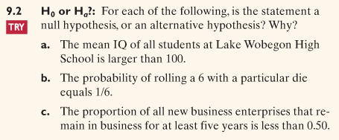

Slide 12
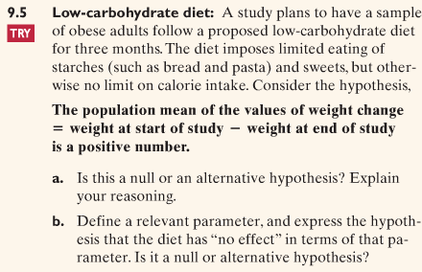

Slide 13
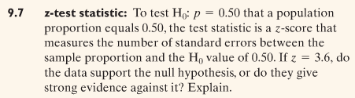

Slide 14
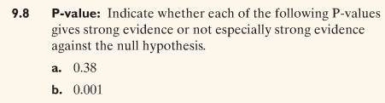

Slide 15
9.2: Significance Tests About Proportions

Slide 16

Learning Objectives:
Steps of a Significance Test & Example
Interpret P-value
Two-Sided Hypothesis Test
P-values for Different Alternative Hypotheses
Significance Level
One-Sided vs Two-Sided Tests
Binomial Test for Small Samples
Divine Proportion
corel.com

Slide 17

Astrologers’ Predictions Better Than Guessing?
Astrologers prepped horoscopes for each subject based on birthdates. For a given adult, his horoscope is shown to the astrologer with his CPI survey and two other randomly selected CPI surveys. The astrologer is asked which survey is matches that adult.
pistefoundation.org

Slide 18
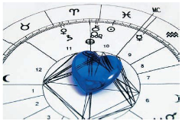
Astrologers’ Predictions Better Than Guessing?
Astrologers were correct for 40 of 116 subjects. Are astrologers’ predictions in this area better than guessing?
Statistics: The Art & Science of Learning from Data, 2E

Slide 19
Step 1: Assumptions
  Variable is categorical
  Data are randomized
  Sample size large enough that sampling distribution of sample proportion is approximately normal:
    np ≥ 15 and
    n(1-p) ≥ 15
Assumptions
Hypotheses
Test Statistic
P-Value
Conclusion
Notes:
The data is categorical – each prediction falls in the category “correct” or “incorrect”
Each subject was identified by a random number. Subjects were randomly selected for each experiment.
np=116(1/3) > 15
n(1-p) = 116(2/3) > 15

Slide 20
Step 2: Hypotheses
Null:
  H₀: p = p₀
Alternative:
  H_{a}: p > p₀ (one-sided) or
  H_{a}: p < p₀ (one-sided) or
  H_{a}: p ≠ p₀ (two-sided)
Assumptions
Hypotheses
Test Statistic
P-Value
Conclusion
Notes:
With random guessing, p = 1/3
The astrologers’ claim: p > 1/3
The hypotheses for this test:
H_{o}: p = 1/3
H_{a}: p > 1/3

Slide 21
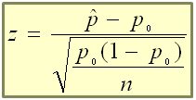
Step 3: Test Statistic
Measures how far sample proportion falls from null hypothesis value, p₀, relative to what we’d expect if H₀ were true
The test statistic is:
Assumptions
Hypotheses
Test Statistic
P-Value
Conclusion
Notes:
In the actual experiment, the astrologers were correct with 40 of their 116 predictions (a success rate of 0.345)
Z = (0.345-1/3)/sqrt((1/3*2/3)/116) = 0.26.

Slide 22
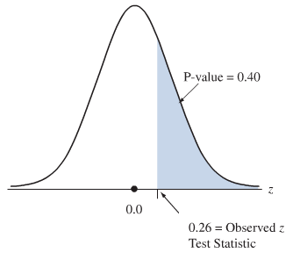
Step 4: P-Value
Assumptions
Hypotheses
Test Statistic
P-Value
Conclusion
Summarizes evidence
Describes how unusual observed data would be if H₀ were true
Notes:
The P-value is 0.40

Slide 23
Step 5: Conclusion
We summarize the test by reporting and interpreting the P-value
Assumptions
Hypotheses
Test Statistic
P-Value
Conclusion
Notes:
The P-value of 0.40 is not especially small
It does not provide strong evidence against H_{0:} p = 1/3
There is not strong evidence that astrologers have special predictive powers

Slide 24

How Do We Interpret the P-value?
The burden of proof is on H_{a}
To convince ourselves that H_{a} is true, we assume H_{a} is true and then reach a contradiction: proof by contradiction
If P-value is small, the data contradict H₀ and support H_{a}
wikimedia.org

Slide 25

Possible Decisions in a Hypothesis Test
P-value: | Decision about H₀:
p ≤ α | Reject H₀
p > α | Fail to reject H₀
To reject or not to reject.
Hamlet
3.bp.blogspot.com

Slide 26

Significance Level
We reject H₀ if P-value ≤ significance level, α
Most common: 0.05
When we reject H₀, we say results are statistically significant
supermarkethq.com

Slide 27
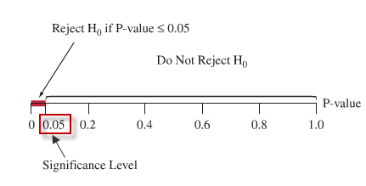
Significance Level Tells How Strong Evidence Must Be
Need to decide whether data provide sufficient evidence to reject H₀
Before seeing data, choose how small P-value needs to be to reject H₀: significance level

Slide 28
Significance Level, α, and Strength
>0.2
Weak
0.1-0.2
Weak to Moderate
0.05-0.1
Moderate
0.01-0.05
<0.01
Strong
Very Strong

Slide 29
Report the P-value
P-value more informative than significance
P-values of 0.01 and 0.049 are both statistically significant at 0.05 level, but 0.01 provides much stronger evidence against H₀ than 0.049
P-value
Statistically Significant

Slide 30

Do Not Reject H₀ Is Not Same as Accept H₀
Analogy: Legal trial
Null: Innocent
Alternative: Guilty
If jury acquits, this does not accept defendant’s innocence
Innocence is only plausible because guilt has not been established beyond a reasonable doubt
mobilemarketingnews.co.uk

Slide 31
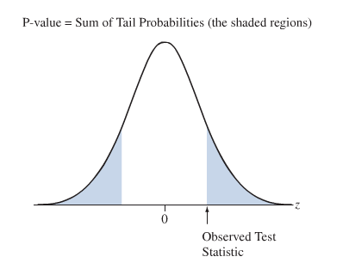
Two-Sided Significance Tests
Two-sided alternative hypothesis H_{a}: p ≠ p₀
P-value is two-tail probability under standard normal curve
Find single tail probability and double it

Slide 32
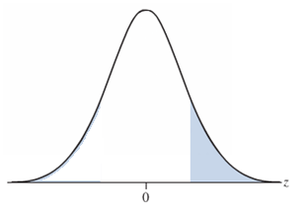
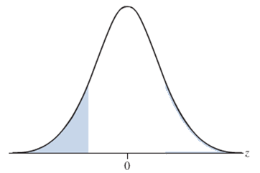
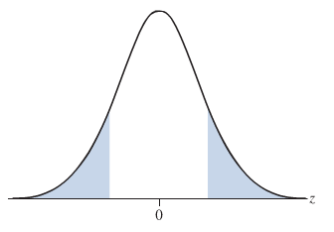
P-values for Different Alternative Hypotheses
Alternative Hypothesis | P-value
H_{a}: p > p₀ | Right-tail probability
H_{a}: p < p₀ | Left-tail probability
H_{a}: p ≠ p₀ | Two-tail probability

Slide 33
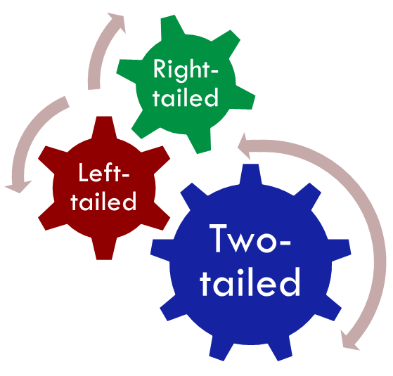
One-Sided vs Two-Sided Tests
Things to consider in deciding alternative hypothesis:
  Context of real problem
  Most research uses two-sided P-values
  Confidence intervals are two-sided

Slide 34
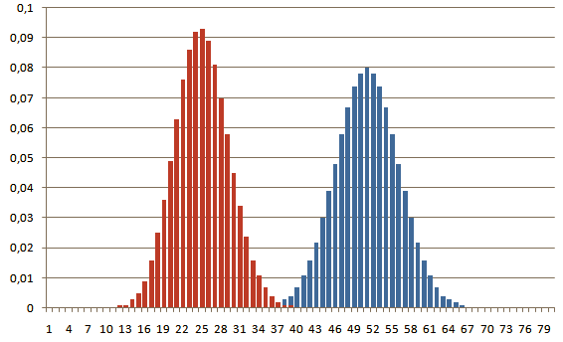
Binomial Test for Small Samples
Significance test of a proportion assumes large sample (because CLT requires at least 15 successes and failures) but still performs well in two-sided tests for small samples
For small, one-sided tests when p₀ differs from 0.50, the large-sample significance test does not work well, so we use the binomial distribution test
cheind.files.wordpress.com

Slide 35
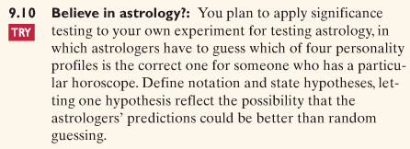

Slide 36
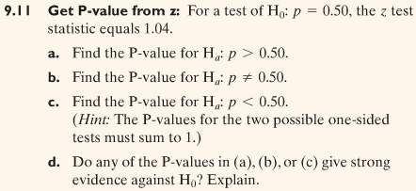

Slide 37
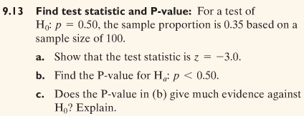

Slide 38
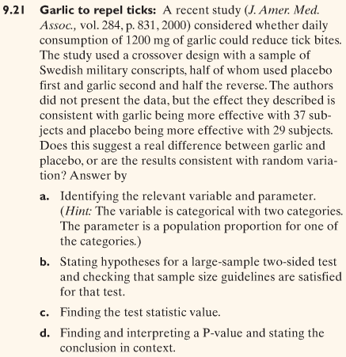

Slide 39
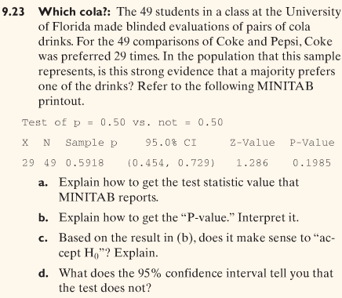

Slide 40
9.3: Significance Tests About Means

Slide 41
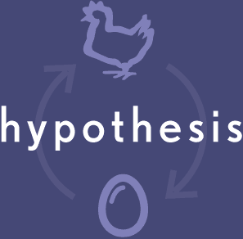
Learning Objectives
Steps of a Significance Test & Example
P-values for Different Alternative Hypotheses
Two-Sided Test and Confidence Interval Results Agree
Population Does Not Satisfy Normality Assumption?
Regardless of Robustness, Look at the Data
zolo.com

Slide 42

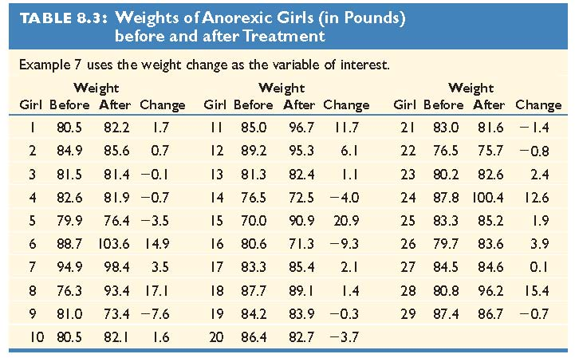
Mean Weight Change in Anorexic Girls
Compared therapies for anorexic girls
Variable was weight change: ‘weight at end’ – ‘weight at beginning’
The weight changes for the 29 girls had a sample mean of 3.00 pounds and standard deviation of 7.32 pounds
Mary-Kate Olson
3.bp.blogspot.com

Slide 43
Step 1: Assumptions
Variable is quantitative
Data are randomized
Population is approximately normal – most crucial when n is small and H_{a} is one-sided
Assumptions
Hypotheses
Test Statistic
P-Value
Conclusion
Notes:
The variable (weight change) is quantitative
The subjects were a convenience sample, rather than a random sample. The question is whether these girls are a good representation of all girls with anorexia.
The population distribution is approximately normal

Slide 44
Step 2: Hypotheses
Null:
  H₀: µ = µ₀
Alternative:
  H_{a}: µ > µ₀ (one-sided) or
  H_{a}: µ < µ₀ (one-sided) or
  H_{a}: µ ≠ µ₀ (two-sided)
Assumptions
Hypotheses
Test Statistic
P-Value
Conclusion
Notes:
Null hypothesis: “no effect”
Alternative hypothesis: therapy is “effective”
H_{0:} µ = 0
H_{a:} µ > 0

Slide 45
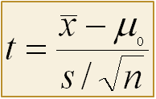
Step 3: Test Statistic
Measures how far (standard errors) sample mean falls from µ₀
The test statistic is:
Assumptions
Hypotheses
Test Statistic
P-Value
Conclusion
Notes:
t = (3.00 – 0)/(7.32/sqrt(29)) = 2.21

Slide 46
Step 4: P-value
The P-value summarizes the evidence
It describes how unusual the data would be if H₀ were true
Assumptions
Hypotheses
Test Statistic
P-Value
Conclusion
Notes:
The P-value is the area to the right of t=2.21 for the t sampling distribution with 28 df. This values is 0.018.
If the treatment had no effect, the probability of obtaining a sample this extreme would be 0.018

Slide 47
Step 5: Conclusions
  We summarize the test by reporting and interpreting the P-value
Assumptions
Hypotheses
Test Statistic
P-Value
Conclusion
Notes:
The small P-value of 0.018 provides considerable evidence against the null hypothesis (the hypothesis that the therapy had no effect)

Slide 48

Mean Weight Change in Anorexic Girls
The diet had a statistically significant positive effect on weight (mean change = 3 pounds, n = 29, t = 2.21, P-value = 0.018)
The effect, however, is small in practical terms
  95% CI for µ: (0.2, 5.8) pounds
Mary-Kate Olson
3.bp.blogspot.com

Slide 49
P-values for Different Alternative Hypotheses
Alternative Hypothesis | P-value
H_{a}: µ > µ₀ | Right-tail probability from t-distribution
H_{a}: µ < µ₀ | Left-tail probability from t-distribution
H_{a}: µ ≠ µ₀ | Two-tail probability from t-distribution

Slide 50
Two-Sided Test and Confidence Interval Results Agree
If P-value ≤ 0.05, a 95% CI does not contain the value specified by the null hypothesis
If P-value > 0.05, a 95% CI does contain the value specified by the null hypothesis

Slide 51
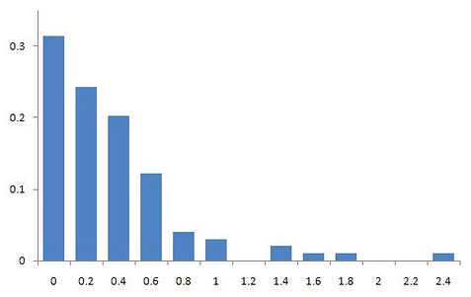
Population Does Not Satisfy Normality Assumption?
For large samples (n ≥ 30), normality is not necessary since sampling distribution is approximately normal (CLT)
Two-sided inferences using t-distribution are robust and usually work well even for small samples
One-sided tests with small n when the population distribution is highly skewed do not work well
farm4.static.flickr.co

Slide 52
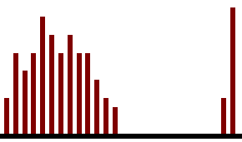
Regardless of Robustness, Look at Data
Whether n is small or large, you should look at data to check for severe skew or severe outliers, where the sample mean could be a misleading measure
scianta.com

Slide 53
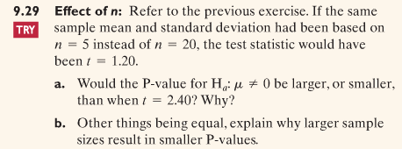

Slide 54
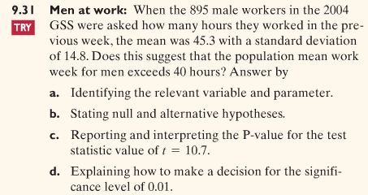

Slide 55
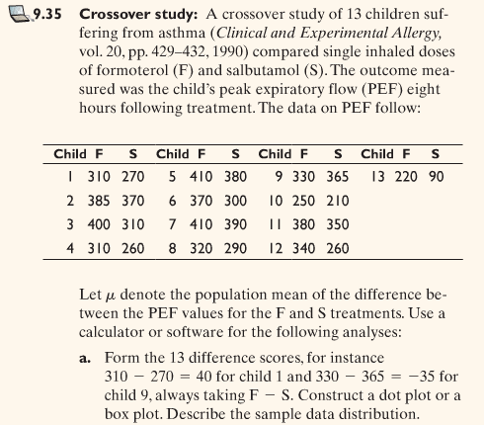

Slide 56
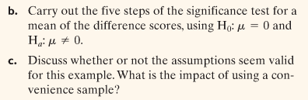

Slide 57
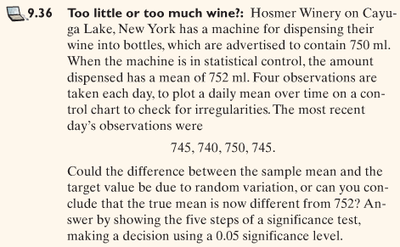

Slide 58


Slide 59
9.4: Decisions and Types of Errors in Significance Tests

Slide 60

Learning Objectives
Type I and Type II Errors
Significance Test Results
Type I Errors
Type II Errors
α, β, and Power
theosophical.files.wordpress.com

Slide 61
Type I and Type II Errors
When H₀ is true and rejected, Type I Error
When H₀ is false and not rejected, Type II Error
As P(Type I Error) goes Down, P(Type II Error) goes Up
Don’t Reject H₀
Reject H₀
Decisions
Correct
Type I
Type II
Correct
H₀ = True
H₀ = False
P(Type I)=α
P(Type II)=β

Slide 62
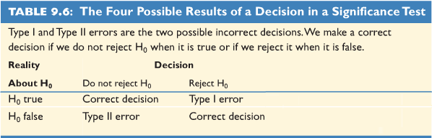
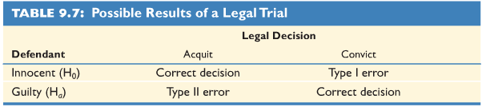
Significance Test Results

Slide 63

Type I
If we reject the null:
  Incorrect only if H₀ is true (Type I)
  Probability is α.
If we reject when null is true and α = 0.05:
  Say there’s a relationship
  No real relationship
  Extremity due to chance
  5% incorrectly reject null
Type I Error
Reject true Null
α

Slide 64

P(Type I Error) = Significance Level α
Type I Error
Reject true Null
α
If H₀ is true, then the probability of rejecting is α (Type I error)
We control α
The more serious a Type I error, the smaller α should be

Slide 65

Decision Errors: Type II
Fail to reject H₀ when H₀ is false and H_{a} is true, Type II error
If we decide not to reject and allow for the plausibility of null hypothesis
  Incorrect only if H_{a} is true
  Probability is β
Type II Error
Don’t reject false null
β

Slide 66


α, β, and Power
Power = Probability an α-test correctly rejects H₀ when H_{a} is true = 1-β
While α is probability of wrongly rejecting H₀, power is probability of correctly rejecting H₀
When μ is close to μ₀, hard to distinguish between (low power); when μ is far from μ₀, easier to find a difference (high power)
Power
Reject H₀ for true H_{a}

Slide 67
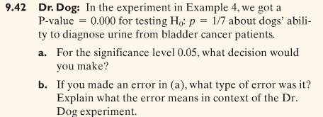

Slide 68
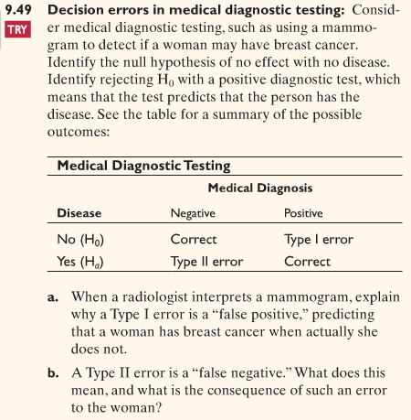
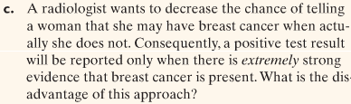

Slide 69
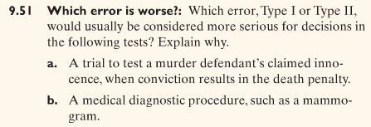

Slide 70
9.5: Limitations of Significance Tests

Slide 71

Learning Objective
Statistical vs. Practical Significance
Significance Tests Less Useful than Confidence Intervals
Misinterpretations of Results of Significance Tests
Where Did the Data Come From?
janezlifeandtimes.files.wordpress.com

Slide 72

What the Significance Test Tells Us
Main relevance is whether true parameter is:
  Above or below what’s hypothesized
  Sufficiently different to be of practical importance
Tells whether parameter differs from hypothesis and its direction
Does not tell practical importance of results
icenews.is

Slide 73
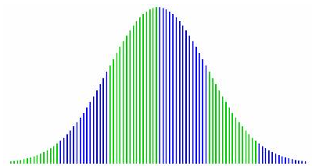
Statistical Significance Does Not Mean Practical Significance
Very large sample size, tiny deviations from null may erroneously be statistically significant
Very small, large deviations might go undetected
Small P-value (0.001) is statistically significant, but does not imply practical significance
iqtestexperts.com

Slide 74
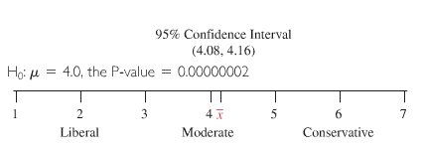
Significance Tests Less Useful Than Confidence Intervals
Significance test merely indicates whether particular hypothesis is plausible or not, but it tells us little about which potential parameter values are plausible
Confidence Intervals display entire set of believable values

Slide 75
Misinterpretations of Results of Significance Tests
P > 0.05 doesn’t mean H₀ is true
“Do Not Reject H₀” doesn’t mean “Accept H₀”
Small P-value doesn’t mean parameter differs much practically
P-value cannot be interpreted as probability that H₀ is true
Misleading to report only statistically significant results

Slide 76
Misinterpretations of Results of Significance Tests
Some may be significant by chance
True effects may not be as large as estimates
People believing H₀ for years need strong evidence
If rejecting H₀ has great consequence, strong evidence is required
Although α = 0.05 is common, there is no set border

Slide 77

Where Did the Data Come From?
Pretend data is probability sample or randomized experiment
Cannot remedy basic flaws such as voluntary samples or uncontrolled experiments
If not probability sample or randomized, conclusions may be debatable if data can be justified
mayjohnstone.co.uk

Slide 78
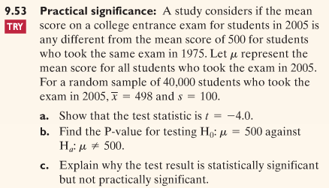

Slide 79
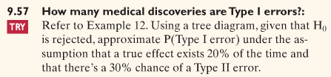
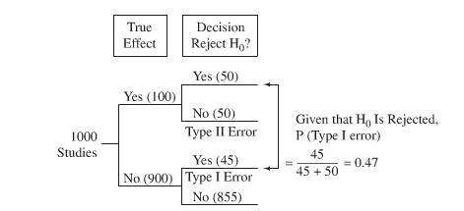

Slide 80
Image Sources
Statistics: The Art and Science of Learning from Data, 2nd Edition, Agresti and Franklin
http://jewishmusicreport.com/wp-content/uploads/2009/06/question-mark-737667.jpg
http://www.corel.com/img/content/community/tips/px/2007-03d/Divine_Proportion_Final_4.jpg
http://www.pistefoundation.org/images/astro-wheel.jpg
http://upload.wikimedia.org/wikipedia/commons/thumb/e/ee/Circle-contradict.svg/207px-Circle-contradict.svg.png
http://supermarkethq.com/pictures/0009/1946/Alpha_BB.JPG
http://3.bp.blogspot.com/_vHf7qNR87Z4/RkwP8AP4MnI/AAAAAAAAATE/aAGaodid1pU/s400/gibson%2Bhamlet%2Byorick.bmp
http://www.mobilemarketingnews.co.uk/Images/18788331/Vodafone_beats_Ofcom_and_Three_in_court_battle_large.jpg
http://cheind.files.wordpress.com/2009/12/binomial_distribution_fair_observerd.png?w=582&h=363
http://www.zolo.com/DESIGN/hypothesis.gif
http://3.bp.blogspot.com/_s2DGfnIqvhw/R1MF4MIFbVI/AAAAAAAABTo/G_5JkJOSrQI/s1600-R/DailyCeleb468280.jpg
http://scianta.com/pubs/images/outliers.gif
http://theosophical.files.wordpress.com/2009/11/error.jpg
http://janezlifeandtimes.files.wordpress.com/2009/05/picket-fence-a.jpg
http://www.icenews.is/wp-content/uploads/2008/05/practical_logo.jpg
http://www.iqtestexperts.com/img/curve.jpg
http://mayjohnstone.co.uk/wp-content/uploads/2008/07/raised-hands.jpg
http://www.millionface.com/l/wp-content/uploads/2008/09/baby-turtle-born-with-two-heads3.jpg
http://www.bionicturtle.com/images/uploads/typeiierror_2bsigtest4.png

