Slide 1
Exam 1 is next week
Wed. March 2rd
Practice questions will be posted on the webpage this Friday
Review session on Tuesday (3/1) evening
- time/room TBA

Slide 2
Major groups within Eudicots
Monocots
Basal
Eudicots
Caryophyllids
Rosids
Asterids
Eudicots

Slide 3
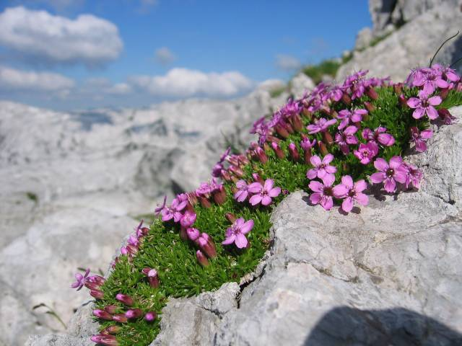
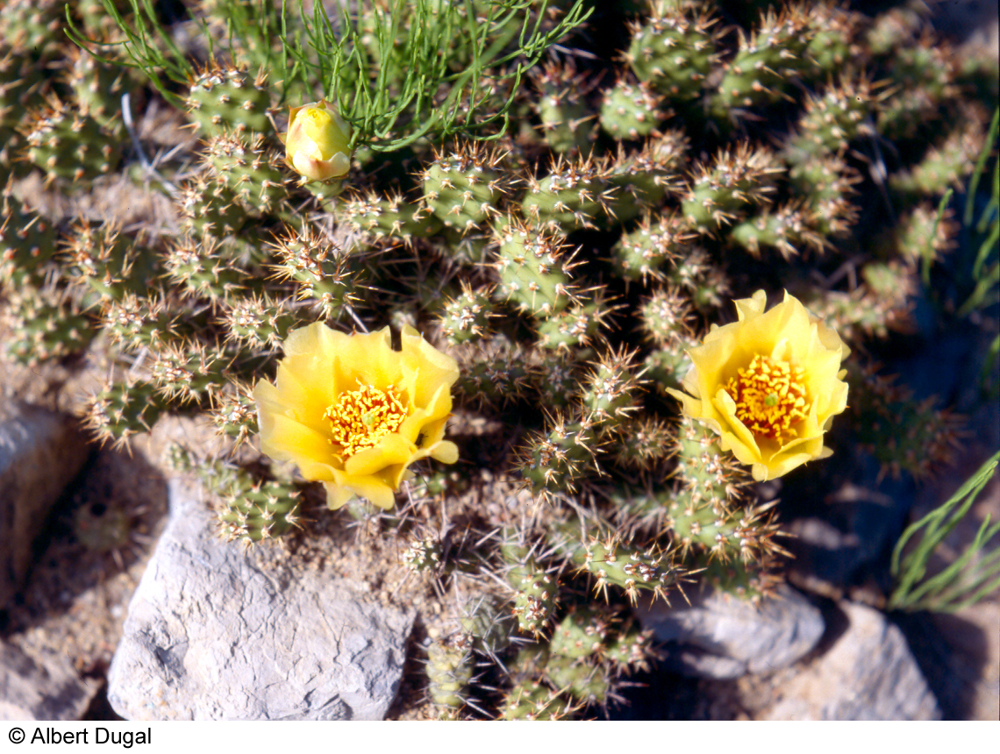
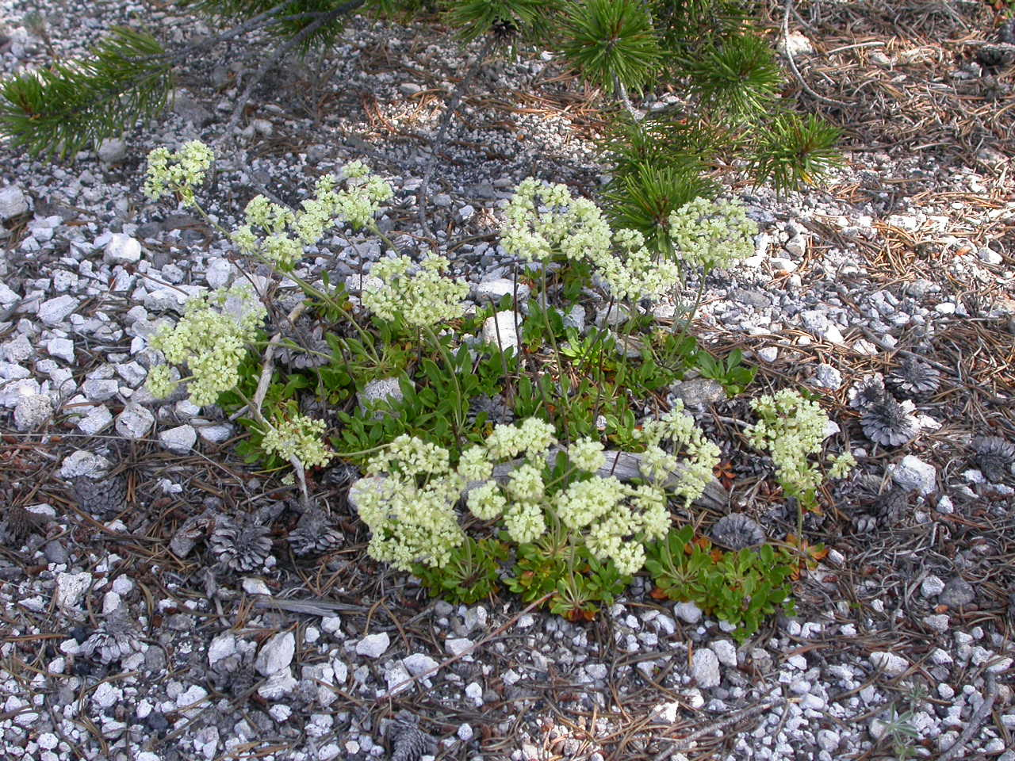
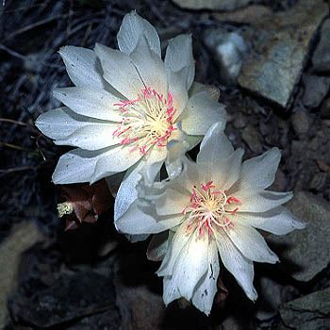
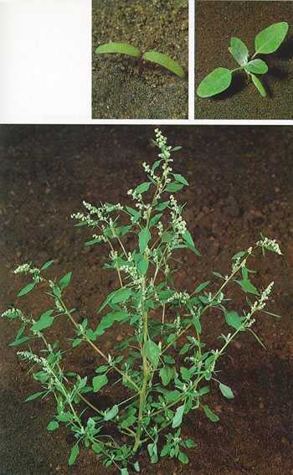
Next: Caryophyllidae
Caryophyllaceae
Opuntia
Lewisia
Polygonaceae
Chenopodium

Slide 4
More floral terms

Slide 5
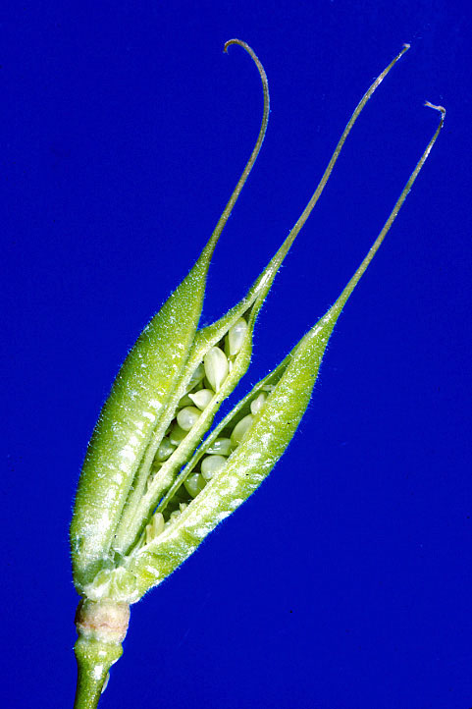
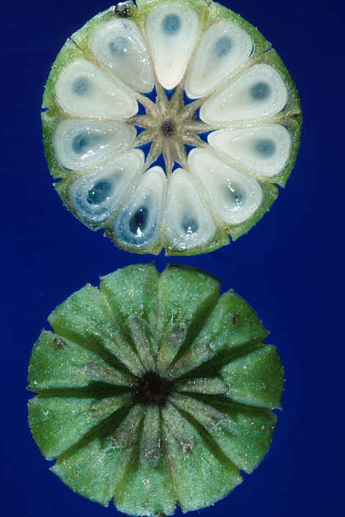
Gynoecium fusion examples
free and distinct
apocarpous
connate/fused
syncarpous

Slide 6
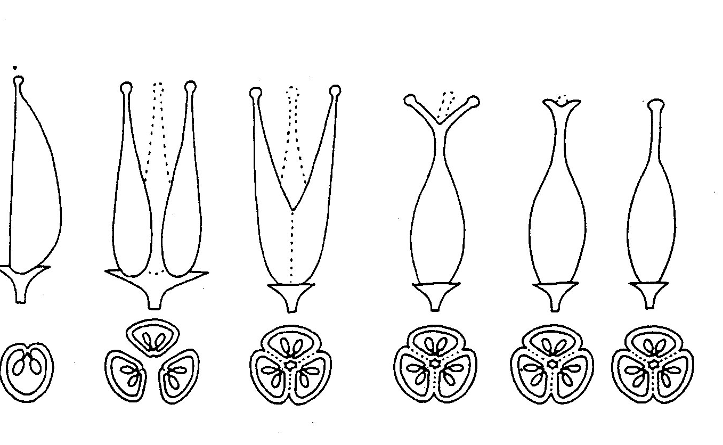
Fusion of the gynoecium
syncarpous (fused carpels)
monocarpous
apocarpous
1 carpel
multiple
unfused
carpels
increasingly fused carpels -->
each with 3 locules (chambers)

Slide 7
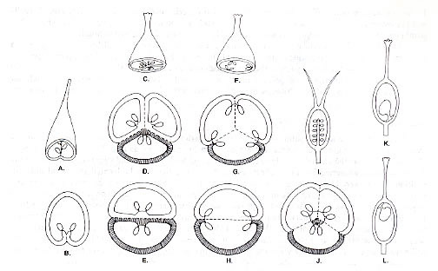
Placentation (arrangement of ovules within ovary)
basal
septum
locule
apical
lateral
axile
parietal
free central

Slide 8
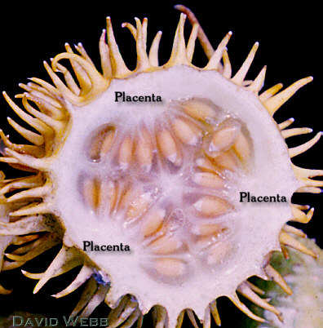
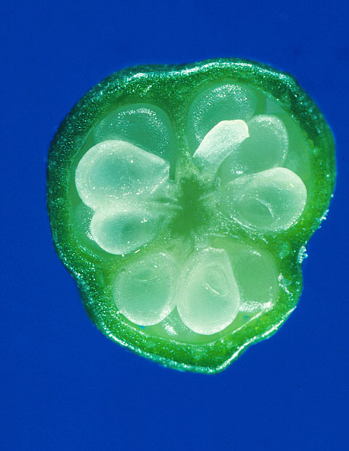

Slide 9
Subclass Caryophyllidae
Monocots
Basal
Eudicots
Caryophyllids
Rosids
Asterids
Eudicots

Slide 10
Next: Caryophyllidae
Caryophyllaceae
Cactaceae
Lewisia
Polygonaceae
Chenopodium

Slide 11
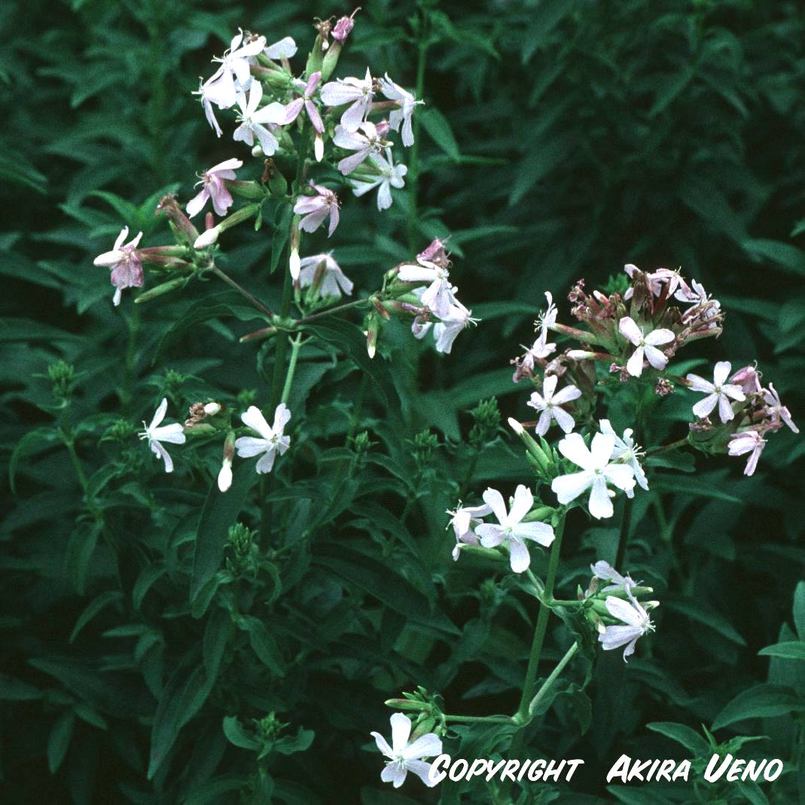
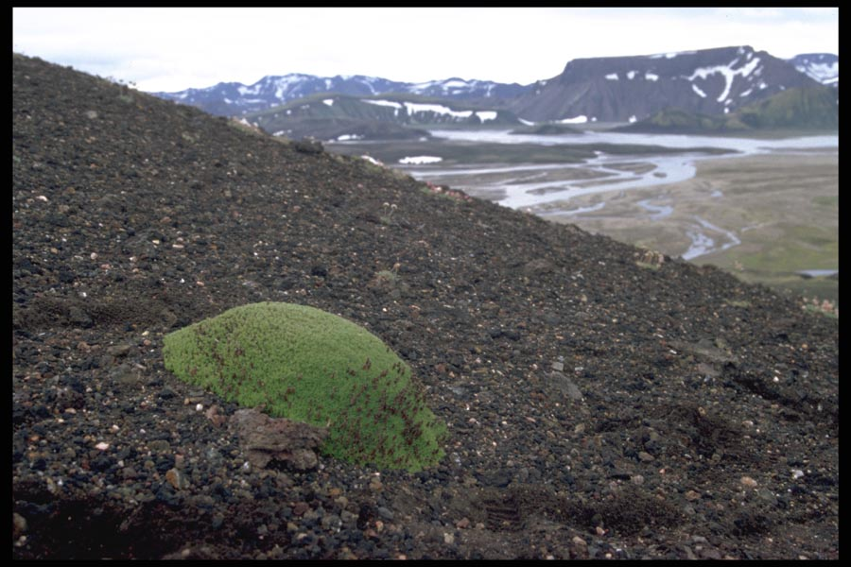

Caryophyllaceae - Carnation (Pink) family
Key features
In Montana: 9th largest --> 14 genera, ~65 species
Life history: annual or perennial herbs, several weedy
Saponaria
Silene acaulis

Slide 12
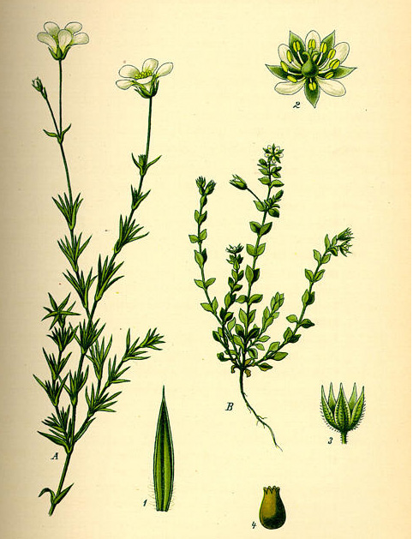
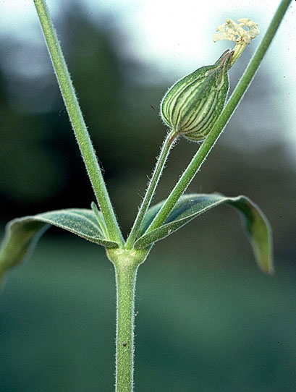

Caryophyllaceae - Carnation (Pink) family
Leaves: opposite, simple & entire
nodes
often
swollen
Arenaria

Slide 13
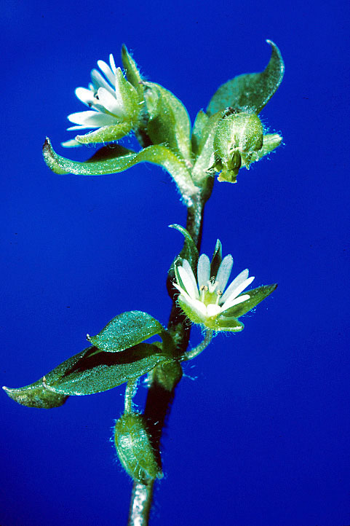
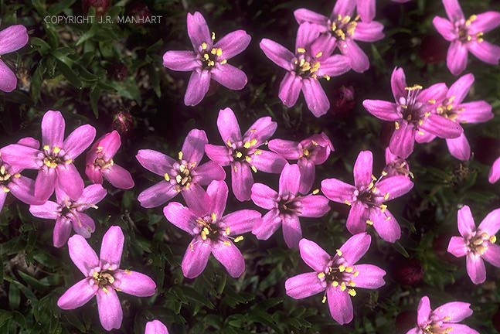

Caryophyllaceae - Carnation (Pink) family
Inflorescences: often solitary
Flowers: regular, usually bisexual
some Silene unisexual (dioecious)
Silene
Stellaria

Slide 14
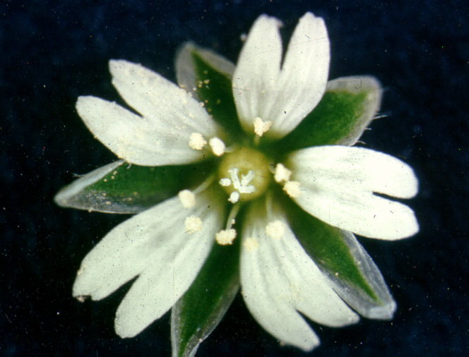
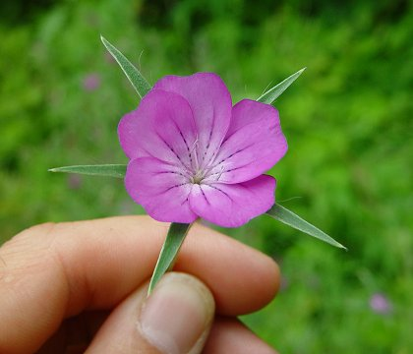

Caryophyllaceae - Carnation (Pink) family
Flower characters
Sepals: 5, often connate
Petals: 5, unfused
Stamens: 5 or 10; usually free & distinct
Agrostemma

Slide 15
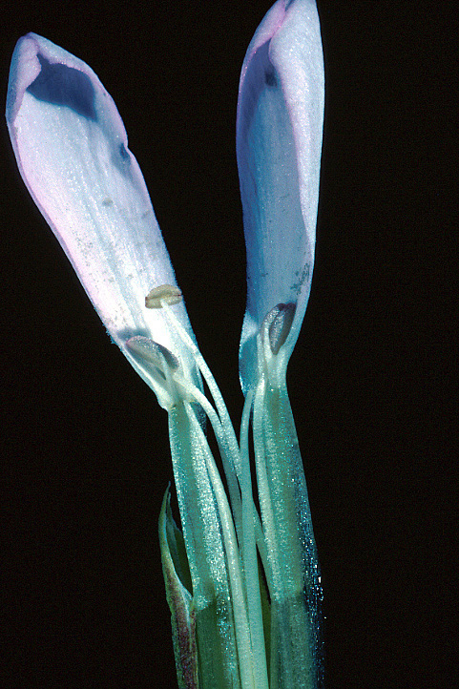
Distinctive “clawed” petals in some genera
blade
claw

Slide 16
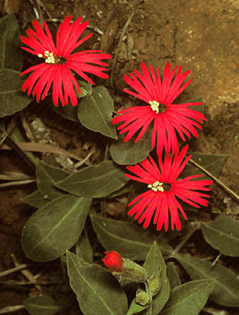
Notched or “pinked” petals
one petal

Slide 17
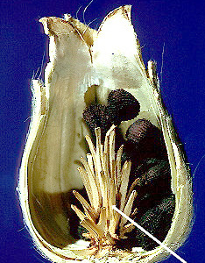
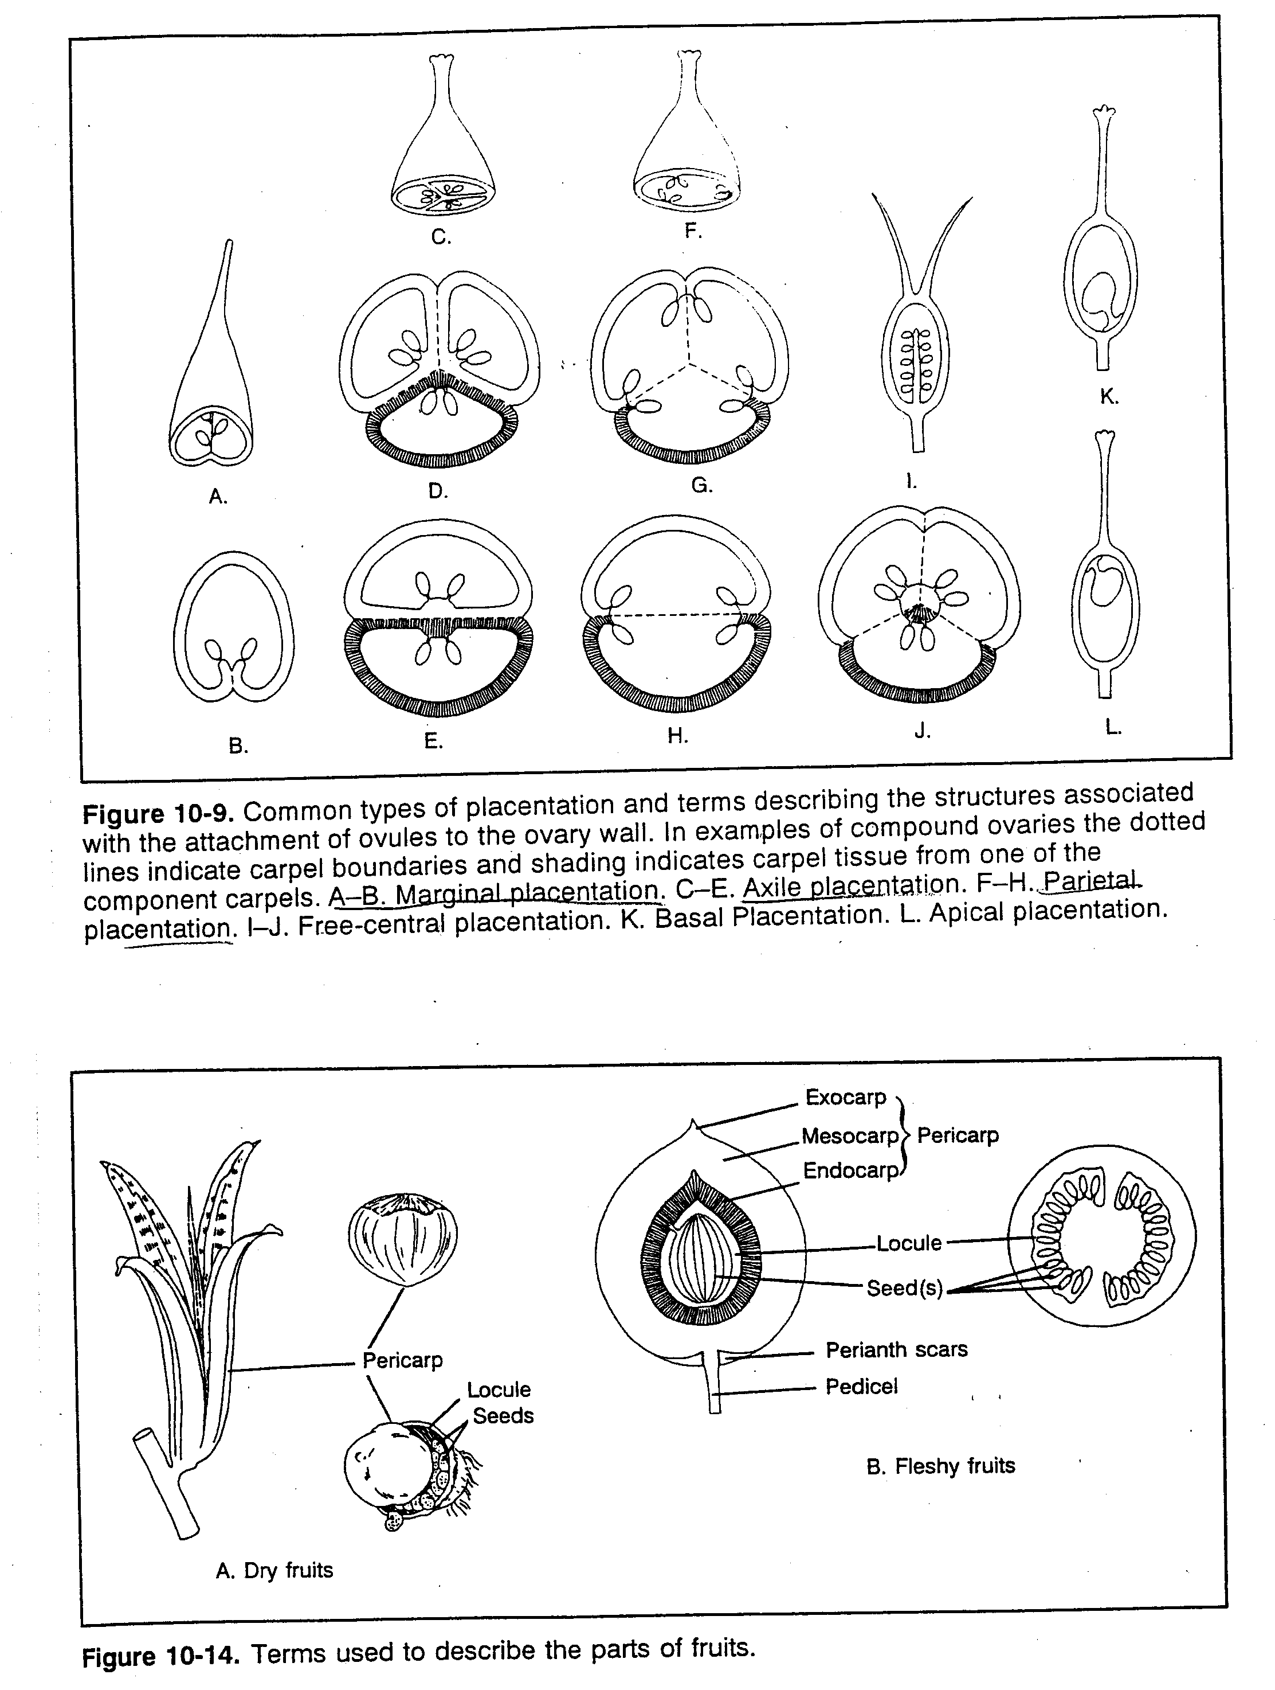

Caryophyllaceae - Carnation (Pink) family
Carpels: 2-5; connate or fused => 1 ovary
superior ovary w/ free central placentation

Slide 18
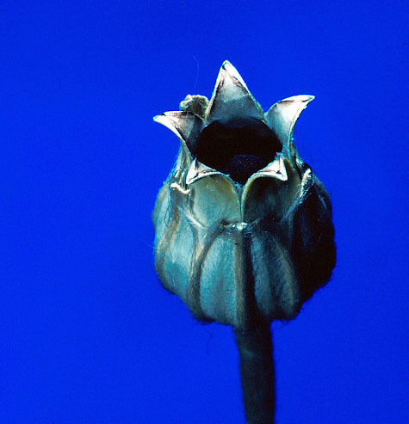
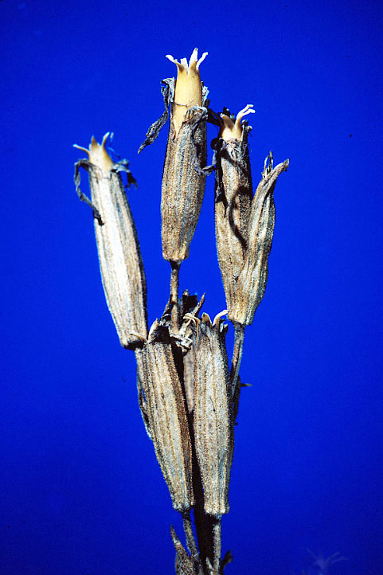

Caryophyllaceae - Carnation (Pink) family
Fruit type: capsule
= dry, dehiscent fruit from a gynoecium w/ >2 carpels

Slide 19
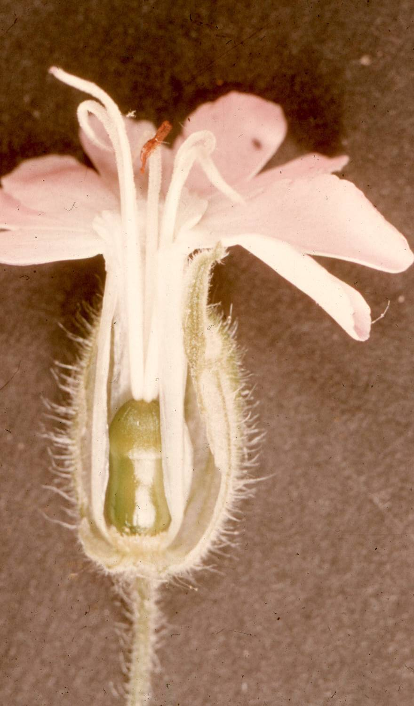
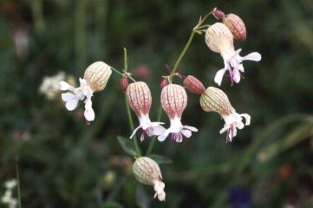

Silene (or Lychnis)
Calyx sometimes inflated
Flowers may be unisexual

Slide 20
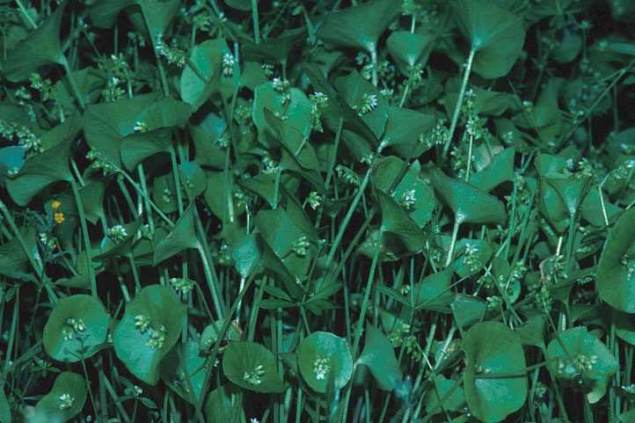
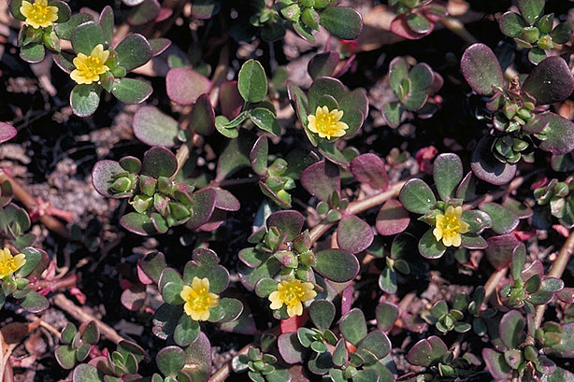
“Portulacaceae” - Purslane family
Key features
In Montana: 7 genera, 16 species
Habit: herbs; sometimes fleshy/succulent
often w/corms, rhizomes or taproots
Leaves: basal, alternate or opposite; usually simple
Claytonia
Portulaca

Slide 21
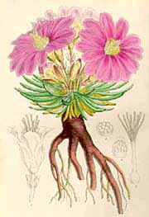

Lewisia rediviva- Bitterroot
leaves basal, thickened
round in cross-section
large taproot
flowers solitary from base
flowers bisexual, regular
The root was an important food resource for native peoples

Slide 22
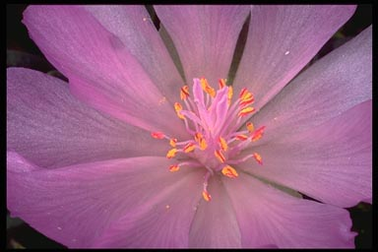
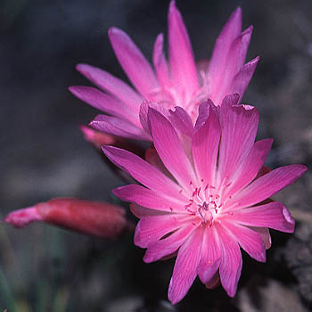

Lewisia rediviva - Bitterroot
Sepals: 2 - 10, subtended by bracts
Petals: many, unfused, straplike
Stamens: many, unfused
Gynoecium: ovary superior
1 fused pistil w/ multiple styles

Slide 23
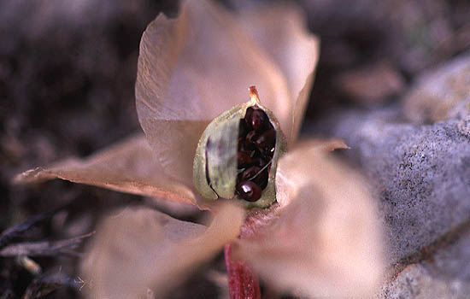

Lewisia rediviva- Bitterroot
Fruit type: a capsule

Slide 24
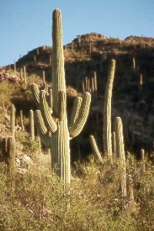
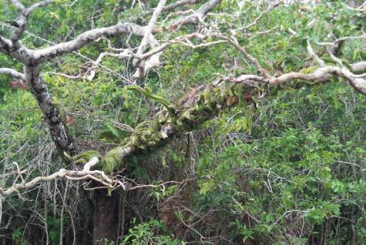
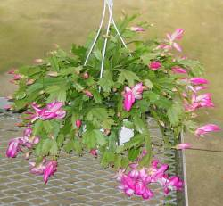
Cactaceae - Cactus family
Worldwide: widespread in temperate/tropical New World
In Montana: 2-3 genera, <10 species
Habit: spiny succulents of deserts, dry places; epiphytes

Slide 25
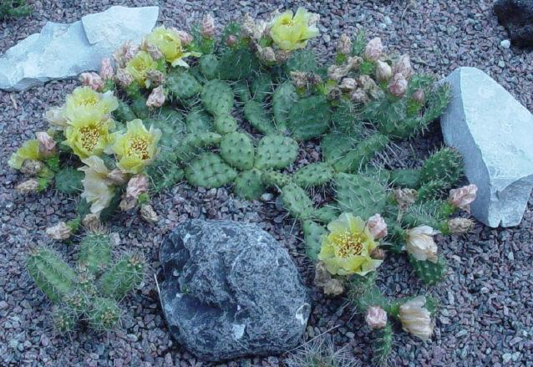
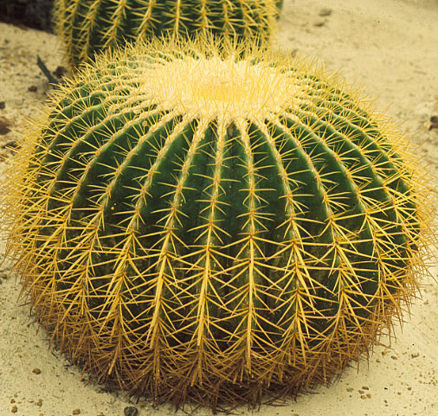
Cactaceae - Cactus family
Stems: modified for photosynthesis and H₂O storage
Leaves: usually lacking (or modified into bristles)
**Use Crassulacean Acid Metabolism (CAM) photosynthesis to conserve H₂O --> only open stomates to fix CO₂ at night

Slide 26
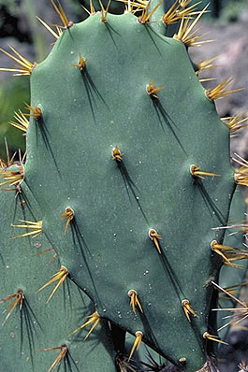
areolae
clusters of bristles and spines

Slide 27
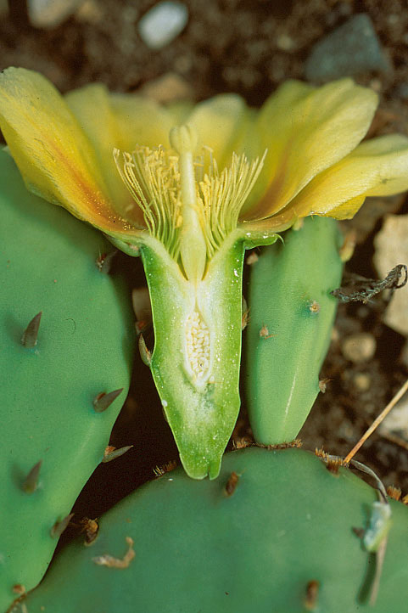
Cactaceae - Cactus family
Inflorescences: often solitary
Flowers:
usually regular
bisexual
sunken into modified stem

Slide 28
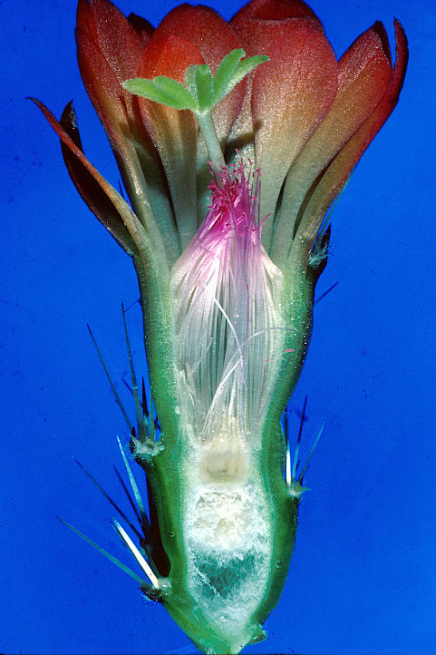
Cactaceae - Cactus family
Flower characters
Sepals: ∞; distinct
Petals: ∞; distinct
Stamens: ∞; distinct
spiralled
Agrostemma

Slide 29
Cactaceae - Cactus family
Flower characters
Carpels: 3 - ∞; fused
stigma often lobed
Agrostemma

Slide 30
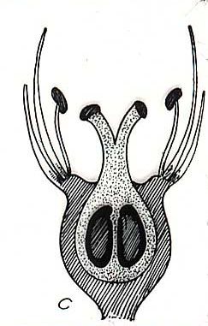
Cactaceae - Cactus family
Hypanthium
(floral cup)
Inferior ovary
Agrostemma

Slide 31
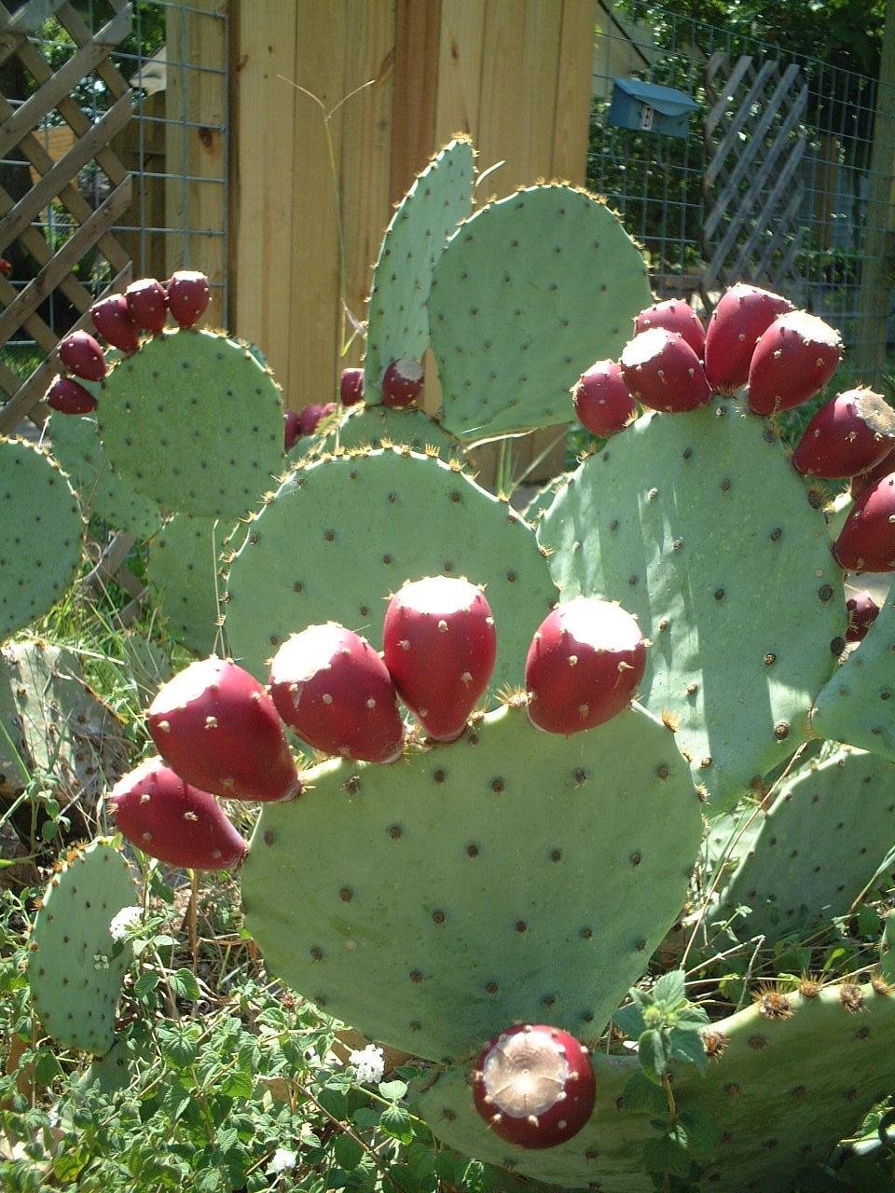
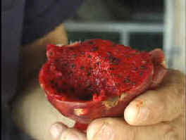
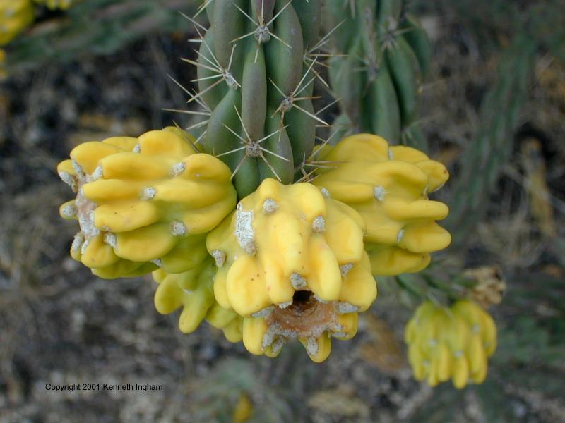
Cactaceae
Fruit type: berry

Slide 32
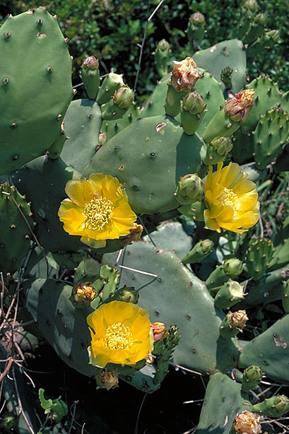

Opuntia - Prickly Pear Cactus
- flowers radially symmetric,
large & usually yellow
- stems usually flattened
- native species low-growing
O. fragilis

Slide 33
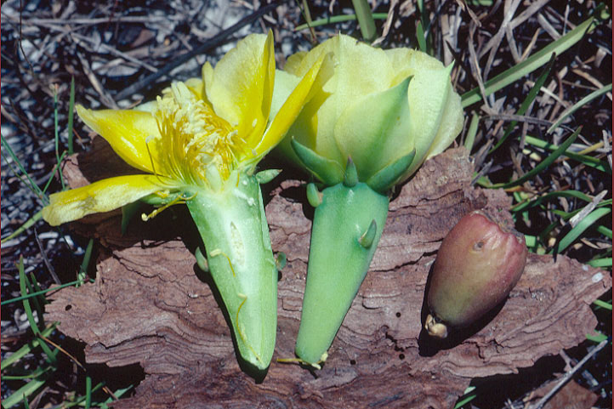

Opuntia - Prickly Pear Cactus

Slide 34
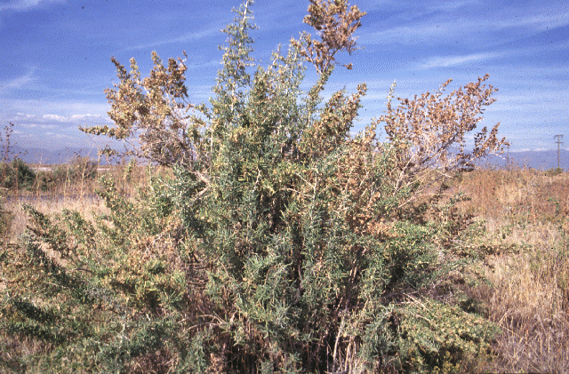
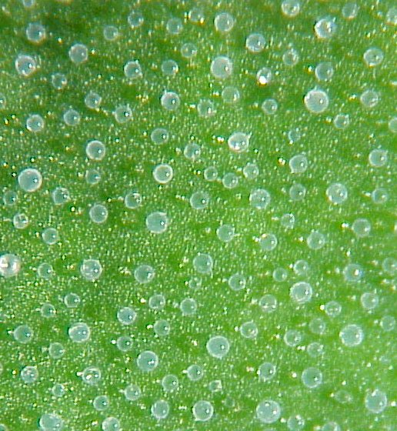
Amaranthaceae - Amaranth family
(includes Chenopodiaceae)
Key features
In Montana: 17 genera, <50 species (most in Chenopodium)
Habit: mostly herbs, some shrubs
Often in disturbed areas, poor soils (e.g. Atriplex)
Atriplex (Saltbush)
Chenopodium
salt glands

Slide 35
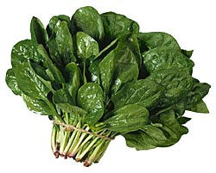



Amaranthaceae - Amaranth family
lots of crops
amaranth
spinach
beets
amaranth seeds

Slide 36

Chenopodium - Goosefoot, Lamb’s Quarters

Habit: herbs, very branchy
Stems: ridged, angular
Leaves: alternate, simple
leaf shape variable
often w/white undersides
C. album
Agrostemma

Slide 37



Chenopodium - Goosefoot
Flowers
Mostly bisexual; radial; reduced
Arranged in dense, “mealy” spikes
Sepals: 5
Petals: 0 or 5
Stamens: 2-5
Pistil: 1 superior ovary, 2-3 styles
Agrostemma

Slide 38



Kochia scoparia (burning bush or summer-cypress)

Slide 39



Polygonales
Droseraceae -
sundews and venus flytraps
Nepenthaceae -
tropical pitcher plants
Drosera - 2 species in Montana
Carnivorous plants -- get nutrients from trapped insects as well as soil

Slide 40



Polygonaceae - Buckwheat family
In Montana: 12th largest -- 5 genera, ~55 species
Habit: mostly herbs, some shrubs
Leaves: simple; alternate or basal
Eriogonum
Rumex

Slide 41


Polygonaceae - Buckwheat family

Sheathing stipule (ocrea)
Rumex

Slide 42


Polygonaceae - Buckwheat family
Inflorescences:
variable
Flowers:
regular, often bisexual
Tepals:
3 - 6 (look like sepals)
Stamens:
3 - 9
Gynoecium:
1 pistil, 1-3 styles
superior ovary

Slide 43


Polygonaceae - Buckwheat family

Fruit type: achene
- usually triangular
Rumex

Slide 44


Polygonum - Knotweeds
~20 species in Montana
several non-native/invasive
- tiny flowers
- sheathing stipules at nodes

Slide 45


Eriogonum - Buckwheats
E. flavum
~20 species in Montana
>50 species in Rockies!
Habit: perennial herbs
- often mat-like or creeping
- taproot/woody root crown
Leaves: basal, simple, entire
- often hairy/fuzzy
- no ocreas

Slide 46


Eriogonum - Buckwheats
Inflorescence:
compound umbel
w/
involucres
(bracty cup at base)

Slide 47
umbel
compound umbel






















involucre = cup of bracts at base of inflorescence

Slide 48


Eriogonum
Flowers:
regular, bisexual
Tepals:
6, connate or distinct
Stamens:
9
Gynoecium:
1 pistil, 3 styles
Color: very variable, even within species (white, pink, yellow)
Fruit: 3-angled achene

Slide 49
Exam 1 – next Wednesday
primarily short-answer questions
  define/use terminology and concepts
    -- don’t forget the systematics/taxonomy lecture material!
  identify parts/terms in drawings
    -- life histories/habits, roots, leaves & stems, flowers, fruits
  identify families/genera from descriptions
    -- Plants-to-know list up to & including today’s plants
  distinguish families/genera using key features
  recognize families/genera from line drawings

